Slide 1
LIFE/work balance
We have started a #LIFEworkbalance campaign and we need your help to complete our LIFE/work balance survey.
We hope to publish the results soon, so please give 15 minutes of your time to help us get a true picture of school life.
Want to be a part of this campaign? Take the survey on our website and share it with your colleagues!
© Classroom Secrets Limited 2019

Slide 2
Year 1 – Summer Block 5 – Money – Recognising Notes
About This Resource:
This PowerPoint has been designed to support your teaching of this small step. It includes a starter activity and an example of each question from the Varied Fluency and Reasoning and Problem Solving resources also provided in this pack. You can choose to work through all examples provided or a selection of them depending on the needs of your class.
National Curriculum Objectives:
Mathematics Year 1: (1M3) Recognise and know the value of different denominations of coins and notes
More Year 1 Money resources.
Did you like this resource? Don’t forget to review it on our website.
© Classroom Secrets Limited 2018

Slide 3
Year 1 – Summer Block 5 – Money
Step 2: Recognising Notes
© Classroom Secrets Limited 2018

Slide 4
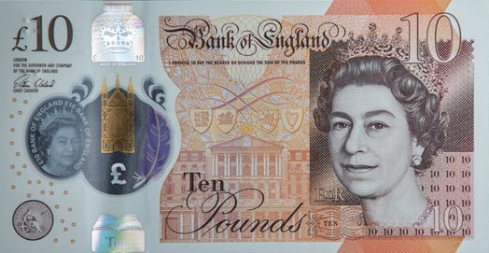
Introduction
How many £1 coins make the same value as this note?

Slide 5
Introduction
How many £1 coins make the same value as this note?
10

Slide 6
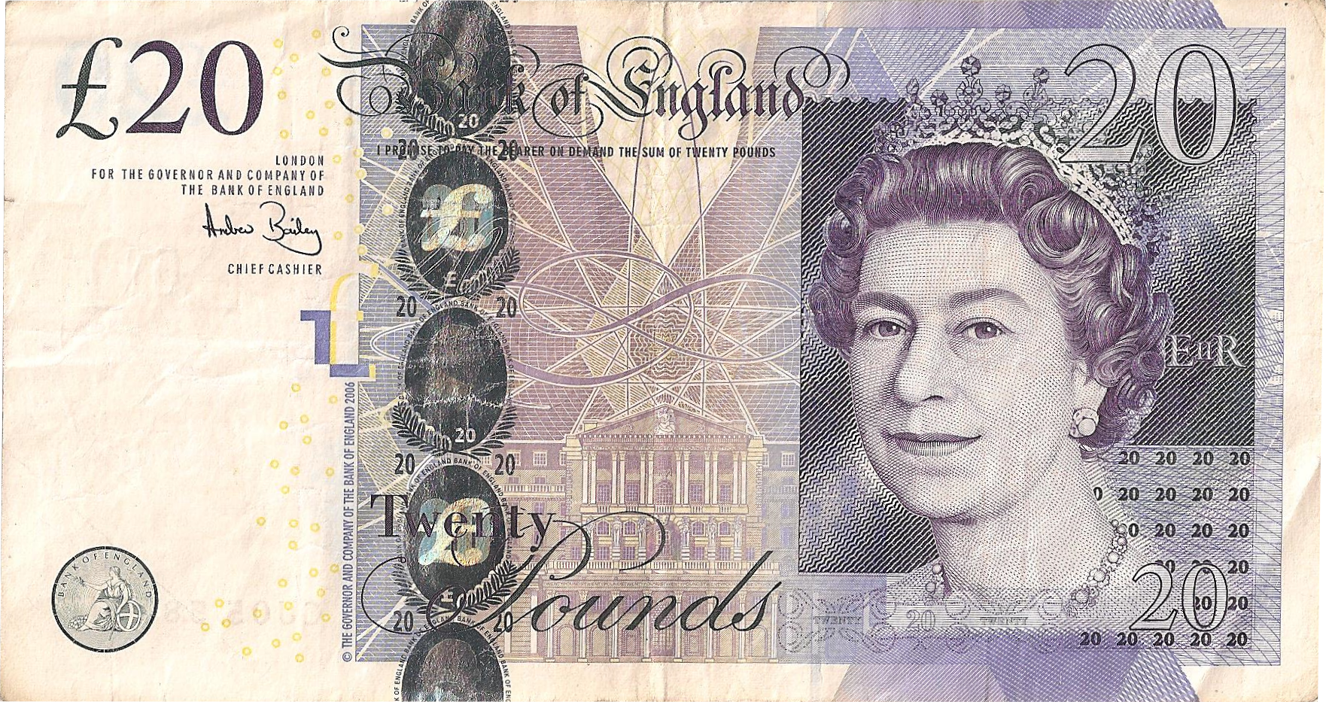
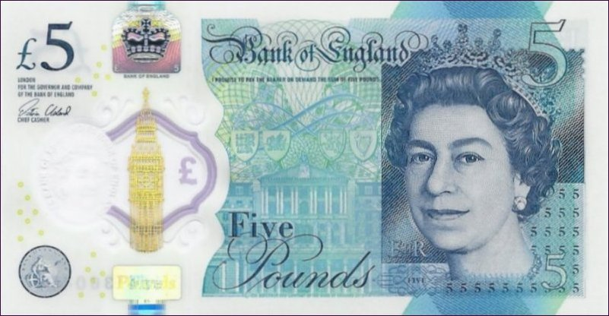
Varied Fluency 1
Match these amounts:
£25
fifty pounds
£40
A.
B.
C.
© Classroom Secrets Limited 2018

Slide 7
Varied Fluency 1
Match these amounts:
£25
fifty pounds
£40
A.
B.
C.
© Classroom Secrets Limited 2018

Slide 8
Varied Fluency 2
True or false?
=
© Classroom Secrets Limited 2018

Slide 9
Varied Fluency 2
True or false?
False
=
£30 | £25
© Classroom Secrets Limited 2018

Slide 10
Varied Fluency 3
What is the value of these notes?
=
=
© Classroom Secrets Limited 2018

Slide 11
Varied Fluency 3
What is the value of these notes?
=
=
£50
£35
© Classroom Secrets Limited 2018

Slide 12
Varied Fluency 4
How many = ?
© Classroom Secrets Limited 2018

Slide 13
Varied Fluency 4
How many = 6
£5 + £5 + £5 + £5 + £5 + £5 = £30
© Classroom Secrets Limited 2018

Slide 14
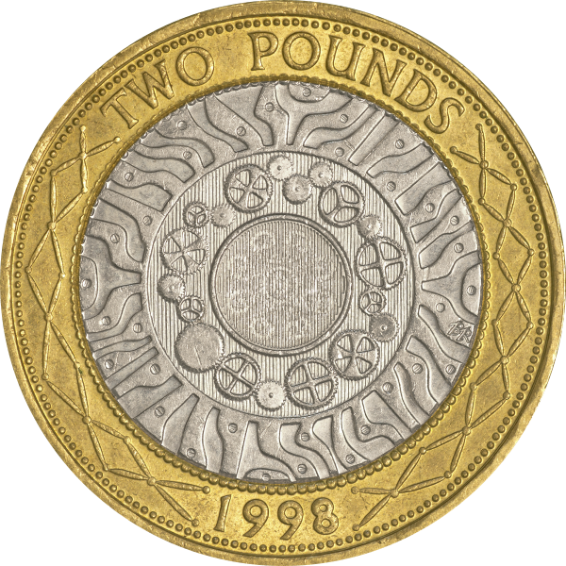
Problem Solving 1
Simon has saved more money than Robert.
Robert has:
Simon has saved less than £35 with two different notes.
What could they be?
© Classroom Secrets Limited 2018

Slide 15
Problem Solving 1
Simon has saved more money than Robert.
Robert has:
Simon has saved less than £35 with two different notes.
What could they be?
Example answer:
Robert has £28, so Simon could have £20 and £10 (£30) which is more than £28.
© Classroom Secrets Limited 2018

Slide 16
Reasoning 1
Doria has three notes in her money box.
Can Doria be correct?
Explain how you know.
I have £30 altogether.
© Classroom Secrets Limited 2018

Slide 17
Reasoning 1
Doria has three notes in her money box.
Can Doria be correct?
Explain how you know.
Yes she can because…
I have £30 altogether.
© Classroom Secrets Limited 2018

Slide 18
Reasoning 1
Doria has three notes in her money box.
Can Doria be correct?
Explain how you know.
Yes she can because
£10 + £10 + £10 = £30
£20 + £5 + £5 = £30
I have £30 altogether.
© Classroom Secrets Limited 2018

Slide 19
Reasoning 2
Do you agree? Explain why.
The second amount is less than the first because there are fewer notes.
© Classroom Secrets Limited 2018

Slide 20
Reasoning 2
Do you agree? Explain why.
No because…
The second amount is less than the first because there are fewer notes.
© Classroom Secrets Limited 2018

Slide 21
Reasoning 2
Do you agree? Explain why.
No because the value of three £5 notes and one £20 note is £35. The value of two £10 notes and one £20 note is £40. The value of the notes is important, not the amount of notes.
The second amount is less than the first because there are fewer notes.
© Classroom Secrets Limited 2018

