Slide 1
LO: Use powerful verbs This will be available as a live lesson and then uploaded to the assignment section.

Slide 2
Starter:
Identify the verb (1), the adverb (1) and the noun (2) in the sentence:
The quick brown fox jumped over the lazy dog.
List 5 different words for the verb walk.

Slide 3
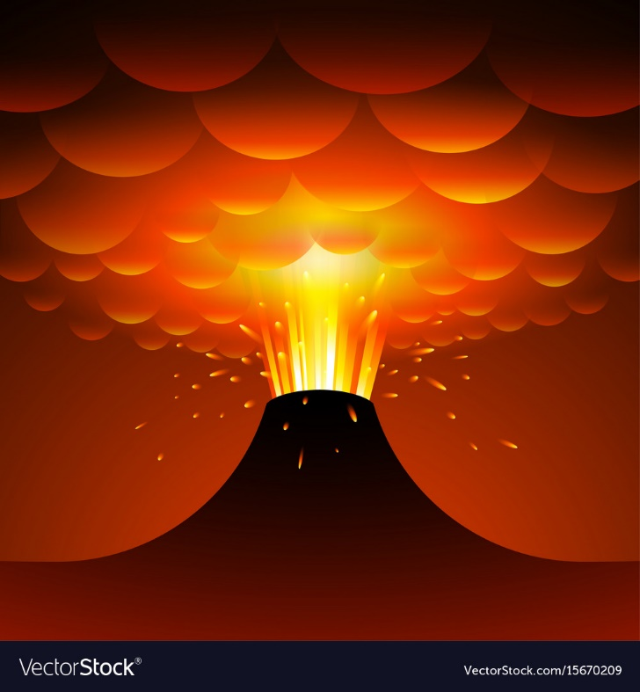
Powerful verbs are exciting action words like ‘stomped’ or ‘trembled’ that make sentences more descriptive and interesting.
Can you use the following words to make up a sentence? As an extra challenge, make you write sentences about the eruption in Escape from Pompeii.
Splatter | Gush
Shudder | Spout
Vanish | Blaze
Shatter | Shudder

Slide 4
Let’s look at how the earthquake is described in the book.
Can you spot any powerful verbs that have been used?
Let’s list them.
Can we add any of your own powerful verbs to describe the start of the eruption?

Slide 5
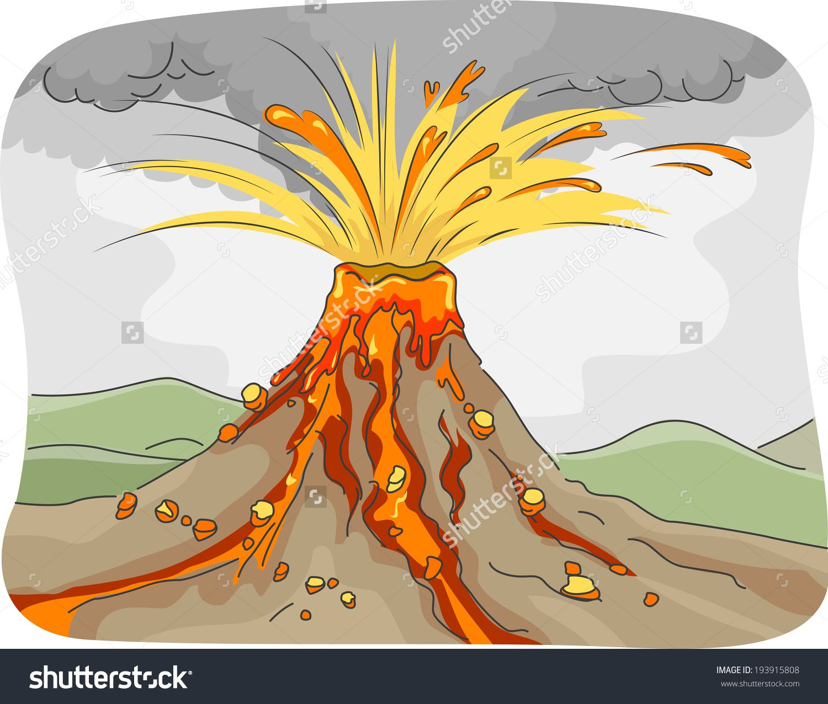
Watch the short video clip showing some volcanic eruptions.
https://www.youtube.com/watch?v=CgpNqrR318U
Use the headings below describe what the different stages of an eruption would be like using powerful verbs. I have given you a few examples to start you off.
The top explodes – explodes, chucks, jolts,
The ash cloud rises up – climbs, travels
Molten lava flows – races, dances
Everything is covered – descends, roams

Slide 6
You are going to write a description for the start of the eruption. Copy out the sentences and change the word in red into your own powerful verb.
Model: In one terrible endless moment, they heard mighty Mount Vesuvius roar. It’s top exploded in a scream and flames ripped upward to the sky.
Model: A massive cloud of silver ash rose to the heavens, twisting and bubbling in every direction until everything was in total darkness.
Now write your own 2 sentences that describes the top exploding and the cloud of smoke raising up to the sky.

Slide 7
Copy these sentences and replace the words in red with your own powerful verbs.
Model: Streams of molten liquid flowed in rivers down the mountain slopes and covered the helpless town nearby.
Model: The walls, streets and gardens of Pompeii disappeared beneath a blanket of ash and stone.
Now write 2 sentences of your own to describe the flow of lava and the town being covered.

