Slide 1
Welcome to Year 4 Pear!
Meet the teacher with Mrs Boswell

Slide 2
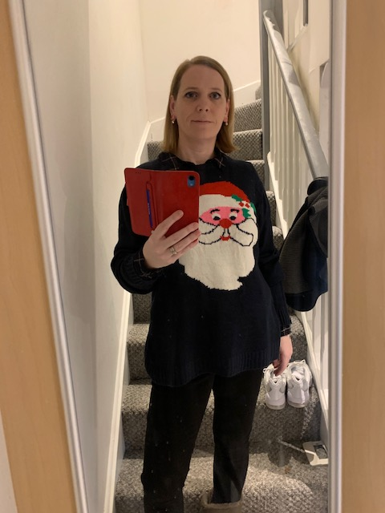
Hello everyone, thank you for having a look at my Power Point.
As I can’t meet you in person I thought you might like to know a bit about me.
I can’t wait to meet you all.
Mrs Boswell

Slide 3
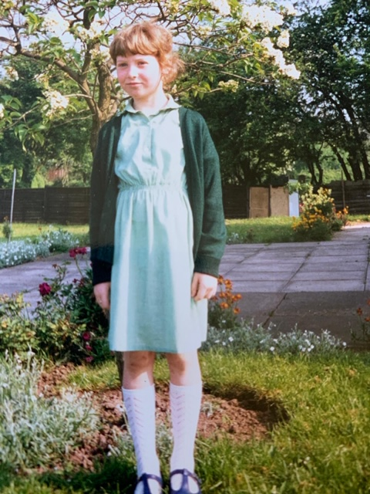
I used to go to St Joseph’s. This is me standing outside the church when I was 7 or 8.

Slide 4
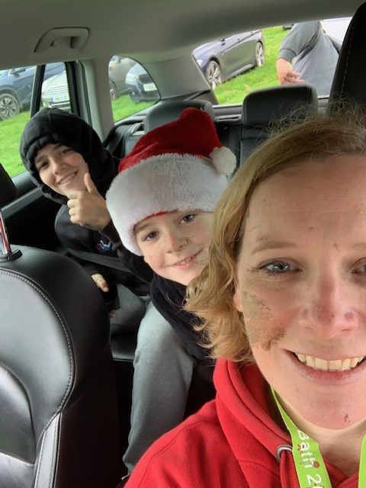
I have 2 children, Sam and Ellie.
Ellie is 15 and goes to Blessed Edward’s.
Sam is 11 and will be starting at Blessed Edward’s in September.
(This photo was taken just after we had taken part in a mud runner at Eastnor Castle last year.)

Slide 5
I have 4 cats. They all look the same, so it’s really hard to know who is who.

Slide 6
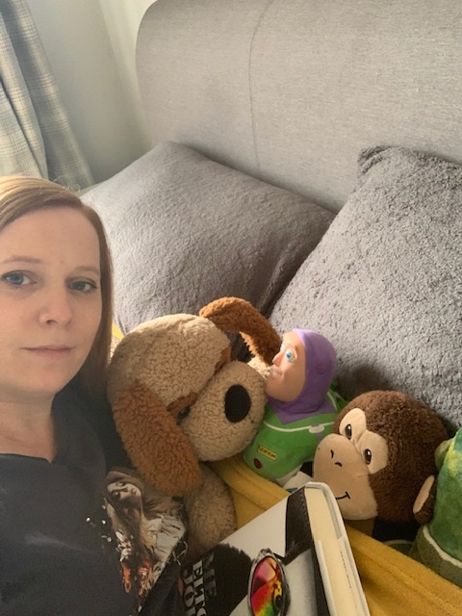
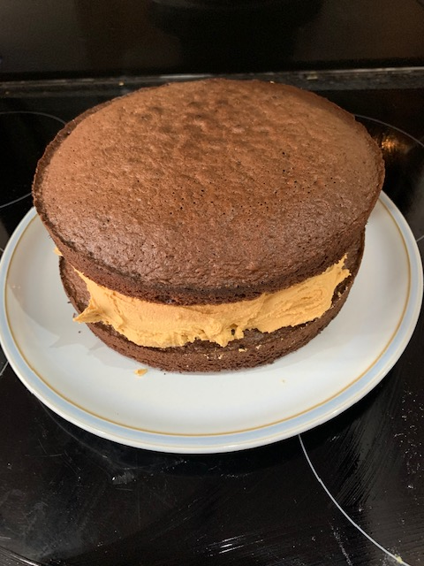
Things I like:
I like to read books.
I like to play tennis (although I’m not very good!)
I like white chocolate!
I like singing loudly to the radio (I’m not very good at that either!)
Baking.
I like to go on holidays.

Slide 7
My favourite subjects at school are:

Slide 8
Now it’s your turn…
Now that you know lots about me, I want to know all about you!
Can you create something to share with me to tell me about you.
This could be a poster, a fact file, a piece of writing or even a PowerPoint like mine.
You can tell me:
Your favourite things.
What you’re looking forward to in Year 4.
If you want to, you can send a picture of it to the class e-mail address or bring it with you in September.
year4pear@st-josephs-pri.worcs.sch.uk

Slide 9
I can’t wait to meet you all.

