Slide 1
Maths at St Joseph’s

Slide 2
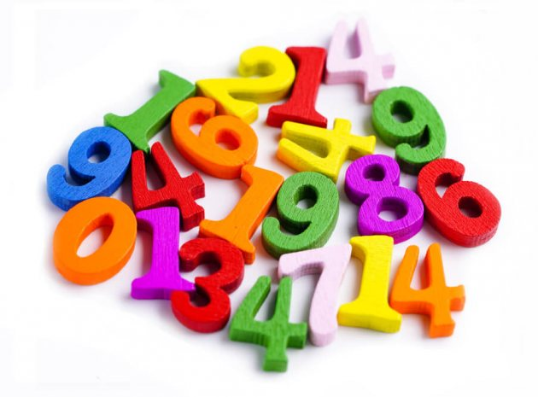
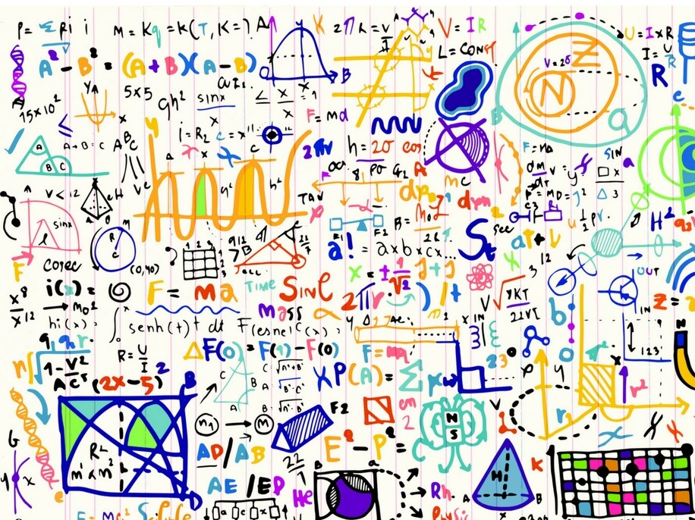
When I leave St Joseph’s…
I am going to be a MATHEMATICIAN.
What will this look like?

Slide 3
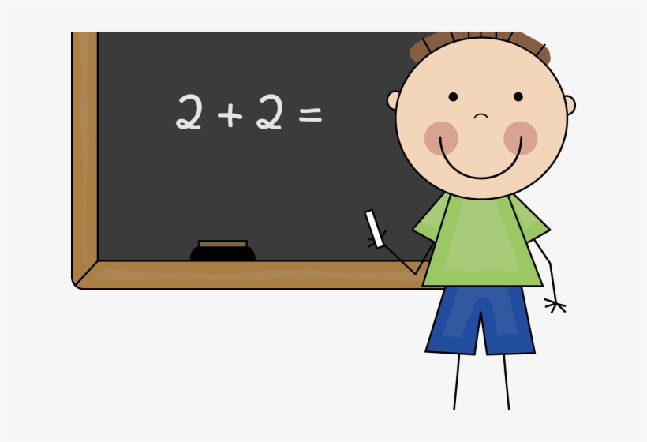
I will be able to…
have a positive attitude towards maths.

Slide 4
I will be able to…
ask lots of questions about maths.

Slide 5
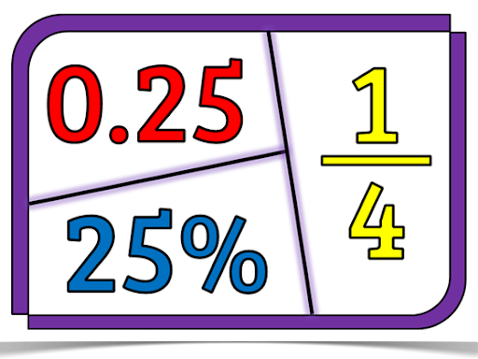
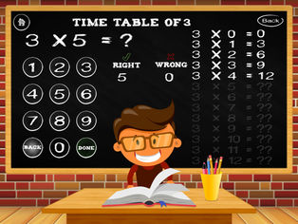
I will be able to…
remember and recite some maths number facts.

Slide 6
I will be able to…
solve problems using what I know to help me.

Slide 7
I will be able to…
give reasons for the answers I got.

Slide 8
I will be able to…
think logically and work systematically.

Slide 9
I will be able to…
work independently and as part of a group.

Slide 10
I will be able to…
communicate my ideas to others.

Slide 11
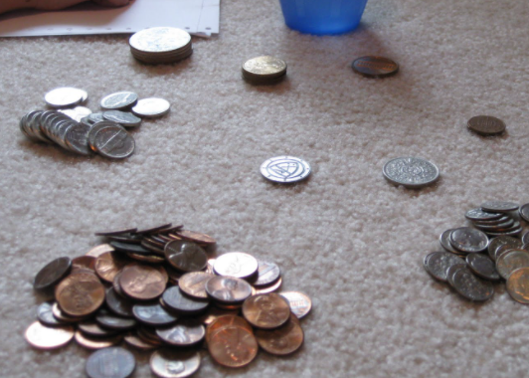
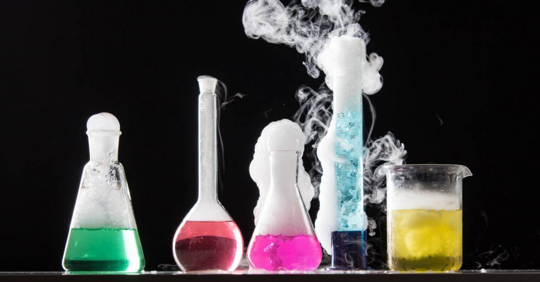
I will be able to…
use and apply my knowledge across the curriculum and in real life situations.

