Slide 1
Catholic Social Teaching

Slide 2
We will be holding weekly food bank collections to donate food to those less fortunate than ourselves.
An important part of being a Catholic is following Jesus’ example to us – he helped others and so should we.
Each week the collection basket will be placed in a different classroom. Can you donate something to help fill the basket?
Donations will then be given to the Worcester Food Bank, a charity that helps people who are in need.

Slide 3
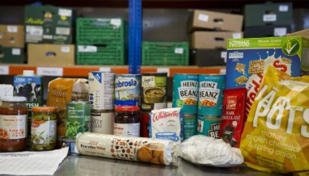
You can donate tins of food, toiletries, packets of food, anything you like. It must be unopened and it must be in date. Please check with your mum and dad first.
Monday 24th April Yr6
Monday 1st May Yr5
Monday 8th May Yr4
Monday 15th May Yr3
Monday 22nd May Yr2
Monday 5th June Yr1
Monday 12th June Reception Class

