Slide 1
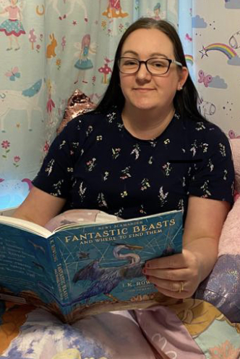
Hello
Hello,
I’m Mrs Nickless from Year 3 Oak. In this video I will tell you a bit about myself.

Slide 2
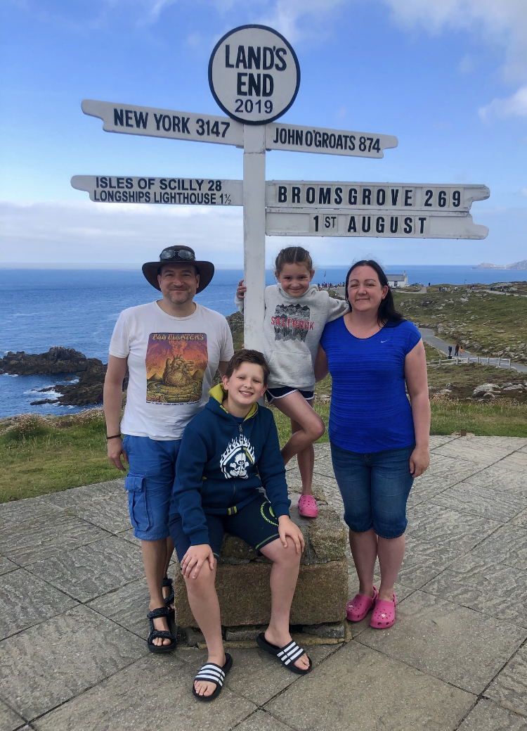
All about me
I live in Bromsgrove with my husband, my son, my daughter and our two cats.
My birthday is in September.
I have brown hair and brown eyes and I wear glasses.

Slide 3
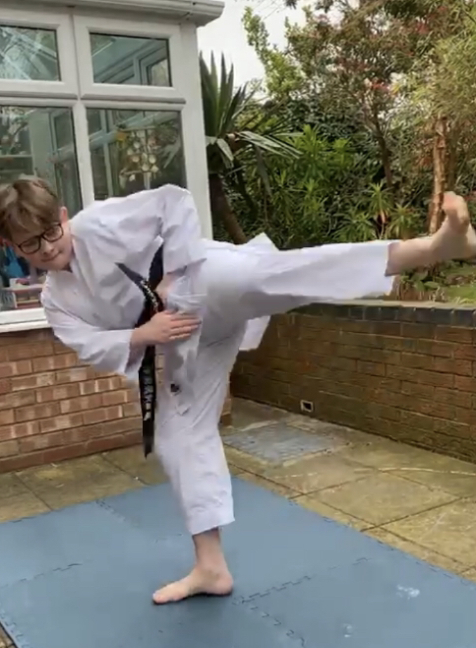
My family
My son is 13. He likes playing the trumpet and doing karate.
Watch out!
He’s a 2nd dan black belt.

Slide 4
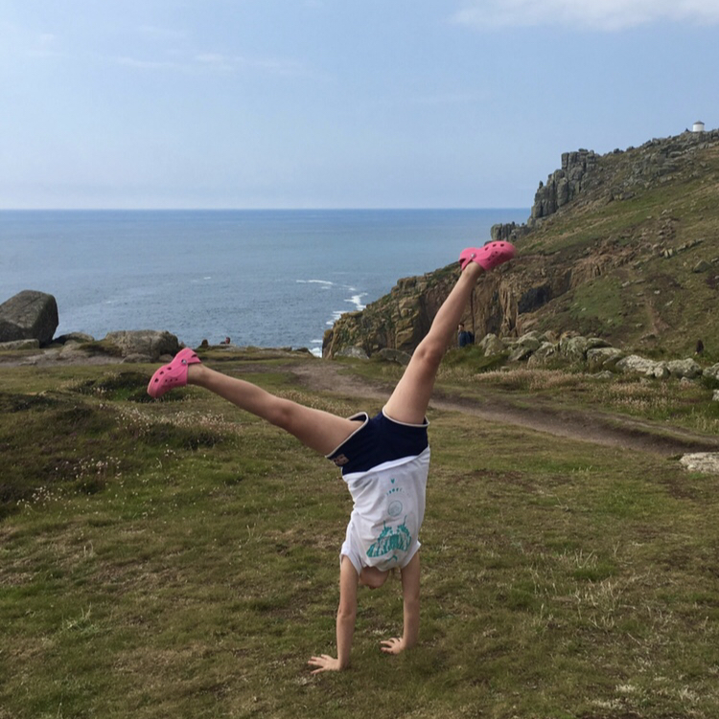
My family
My daughter is 10. She likes reading Harry Potter and doing gymnastics.
She’s always upside down!

Slide 5
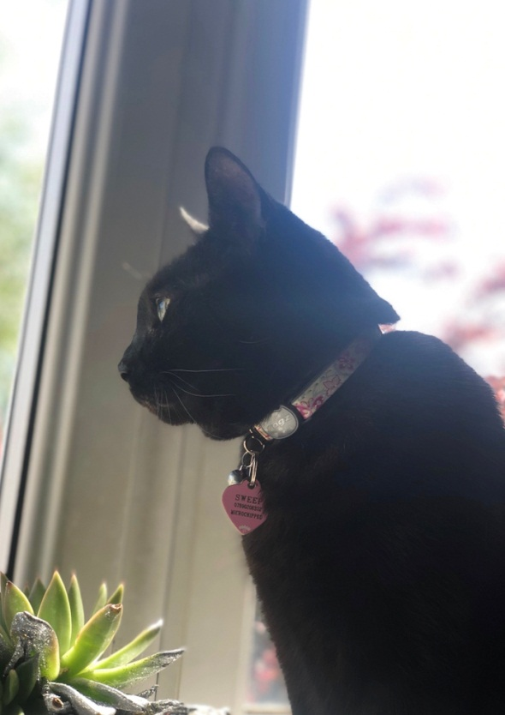
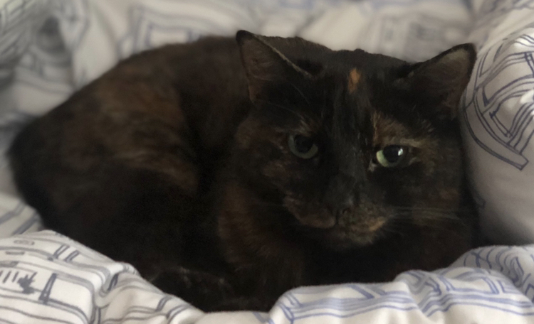
My pets
I love cats.
Here are my two cats. They are called Sweep and Rosie.

Slide 6
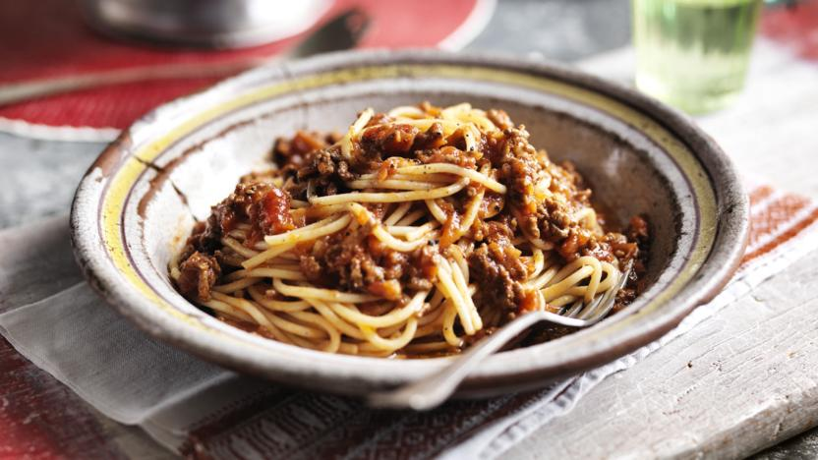
My favourite food
I love Italian food.
My favourite meal is spaghetti bolognese.

Slide 7
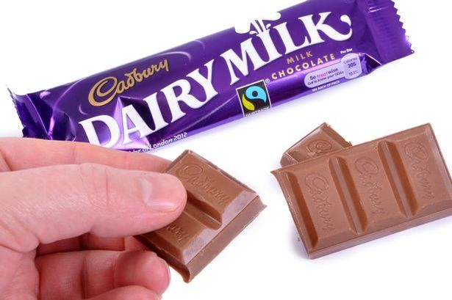
My favourite treat
My favourite treat is chocolate.

Slide 8
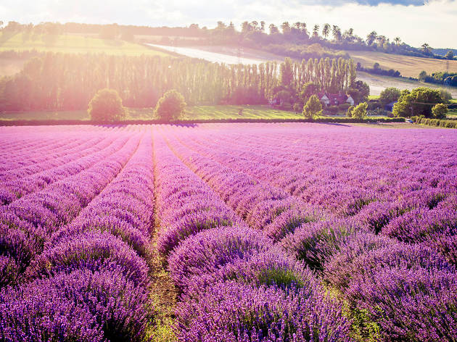
My favourite colour
My favourite colour is purple.

Slide 9
My favourite subjects
My favourite subjects are:
RE
History
Art
Maths

Slide 10
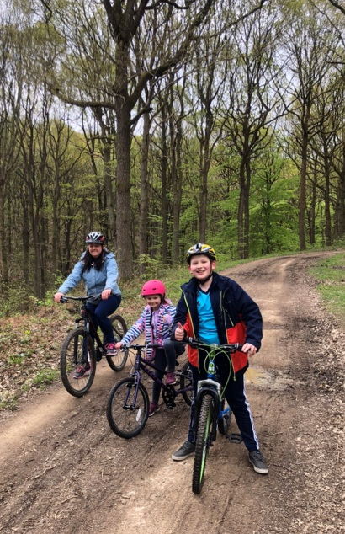
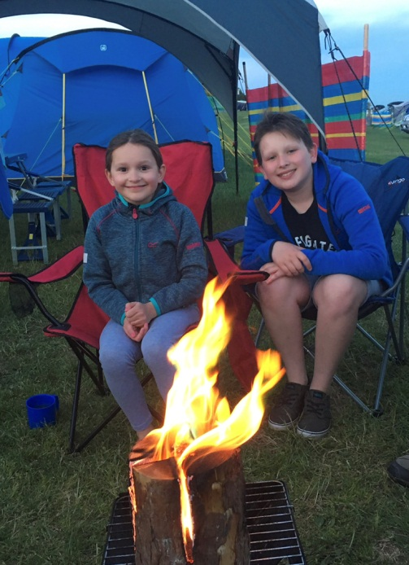
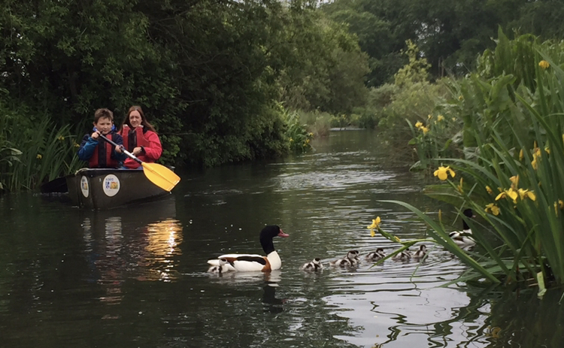
My hobbies
I love spending time with my family. We like to go for walks and on bike rides together. Our favourite thing to do together is to go camping.

Slide 11
Now it’s your turn
Tell me a bit about yourself.
You could write me a letter or make a PowerPoint like me! It’s up to you.
I am looking forward to finding out more about you and I can’t wait until we can meet each other at school.
Mrs Nickless

