Slide 1
Hello!
I’m Miss Malpass from Year 3 Pear.

Slide 2
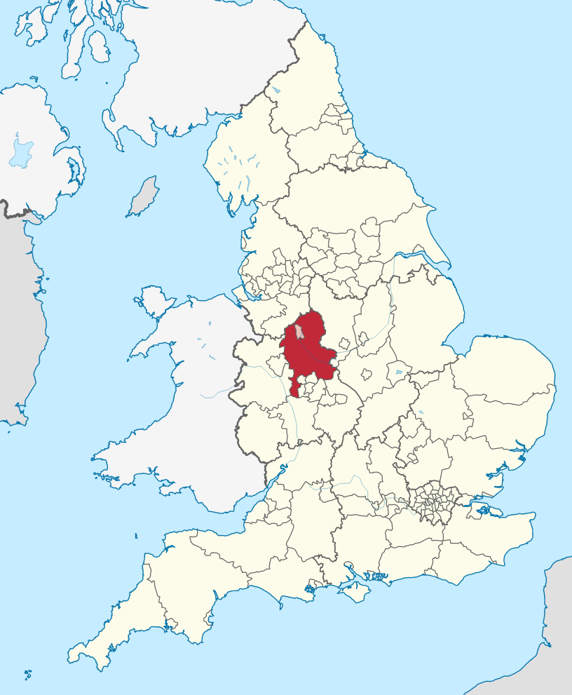
About Me
I am 27 years old. My birthday is the 14th March.
I am the eldest of 3. I have a younger brother and sister.
I come from Newcastle-under-Lyme originally but I have lived in Worcester for 9 years now.
I have been a teacher for 6 years.

Slide 3
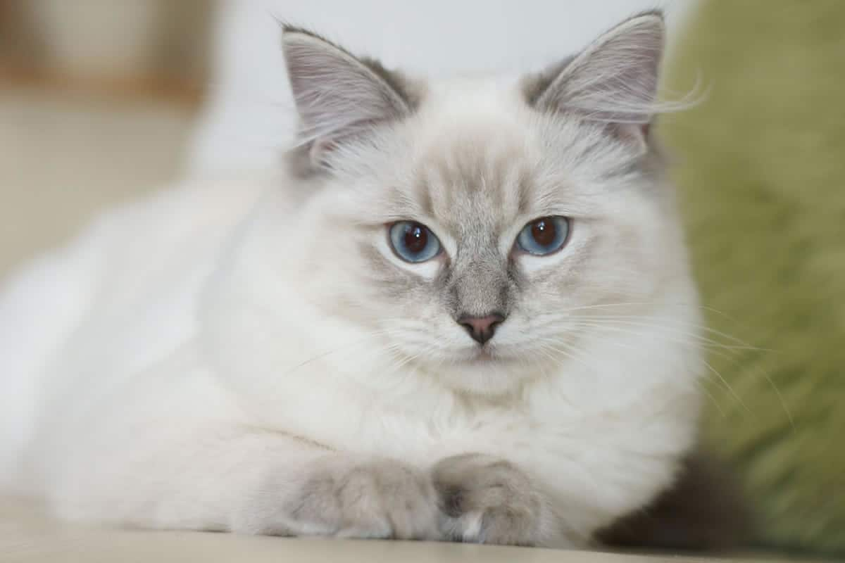
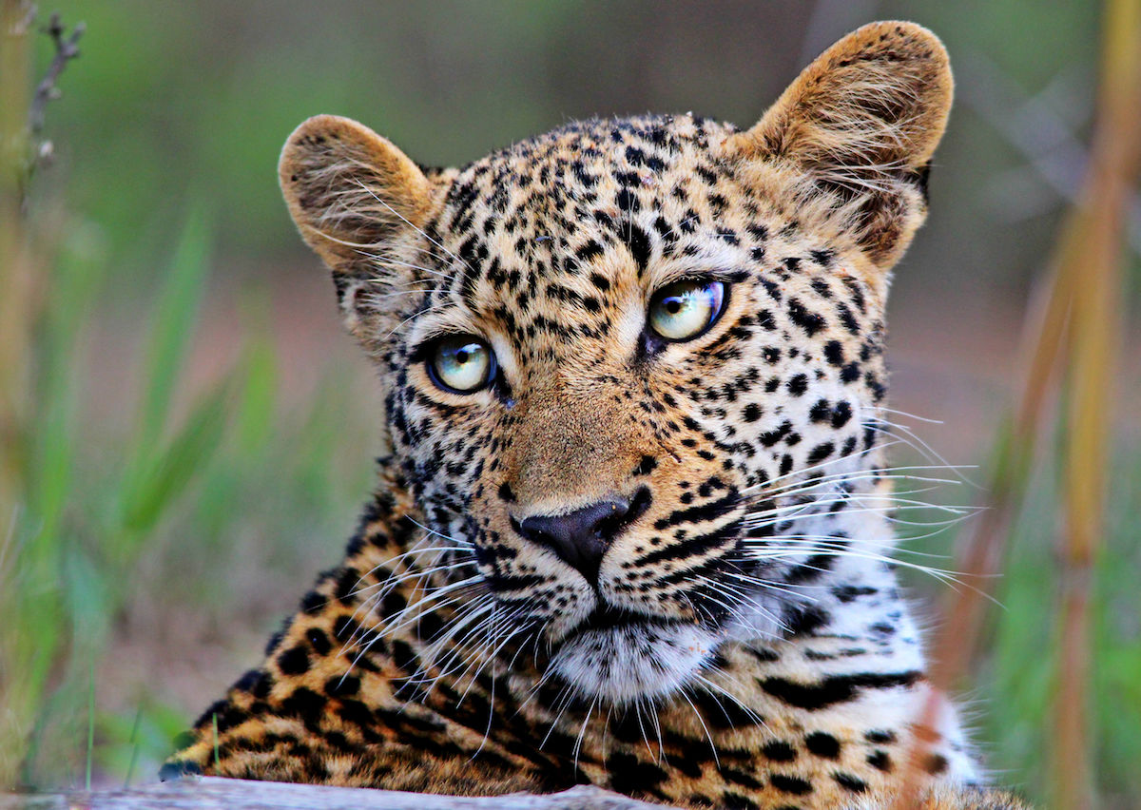
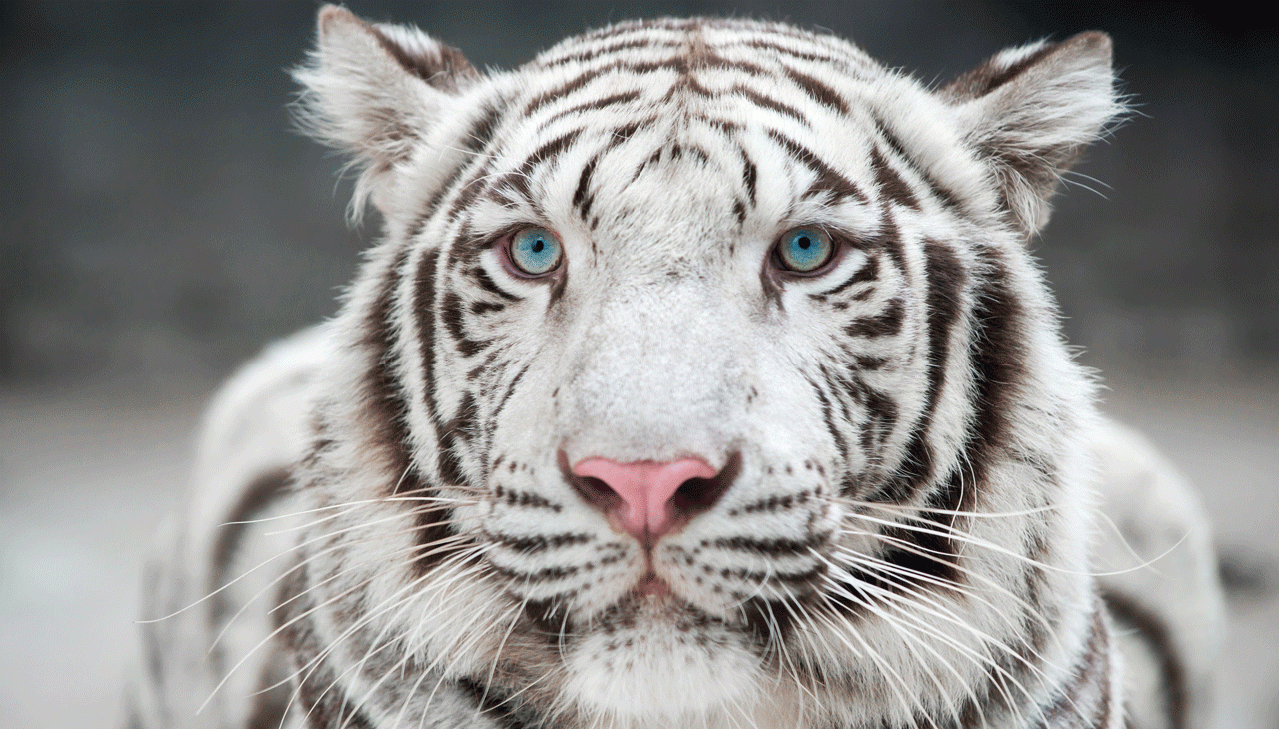
My favourite animal – Cats!

Slide 4
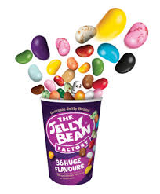
My Favourite Treats!

Slide 5
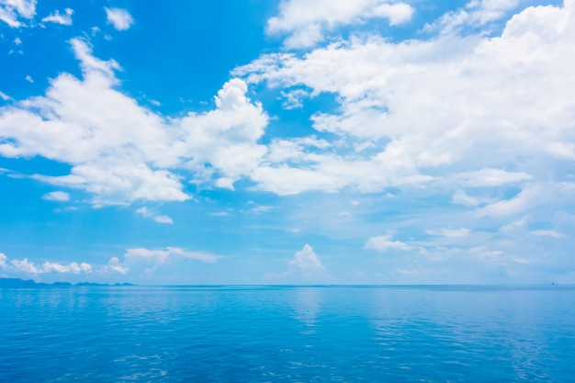
My Favourite Colour- Blue!

Slide 6
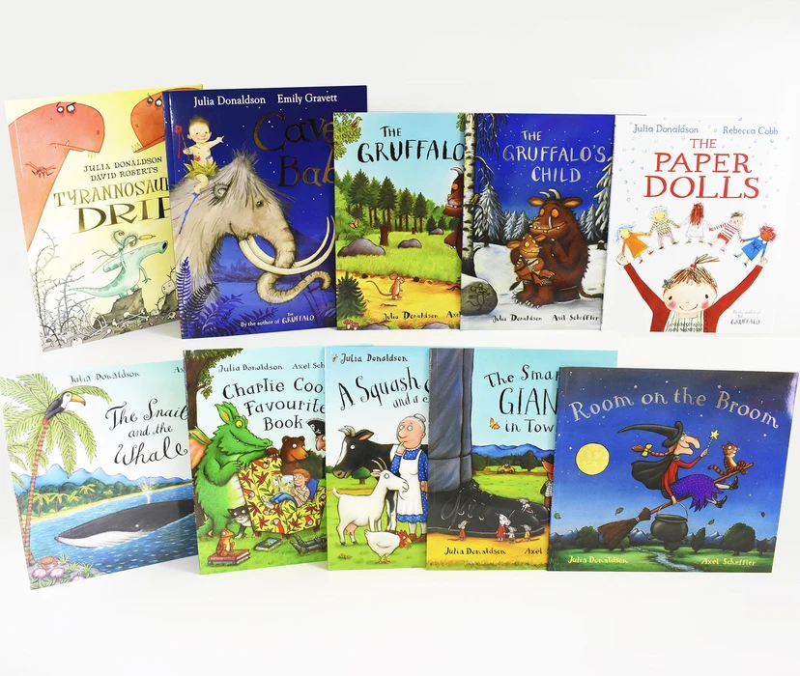
My Favourite Subjects
English
Science
RE
Art

Slide 7
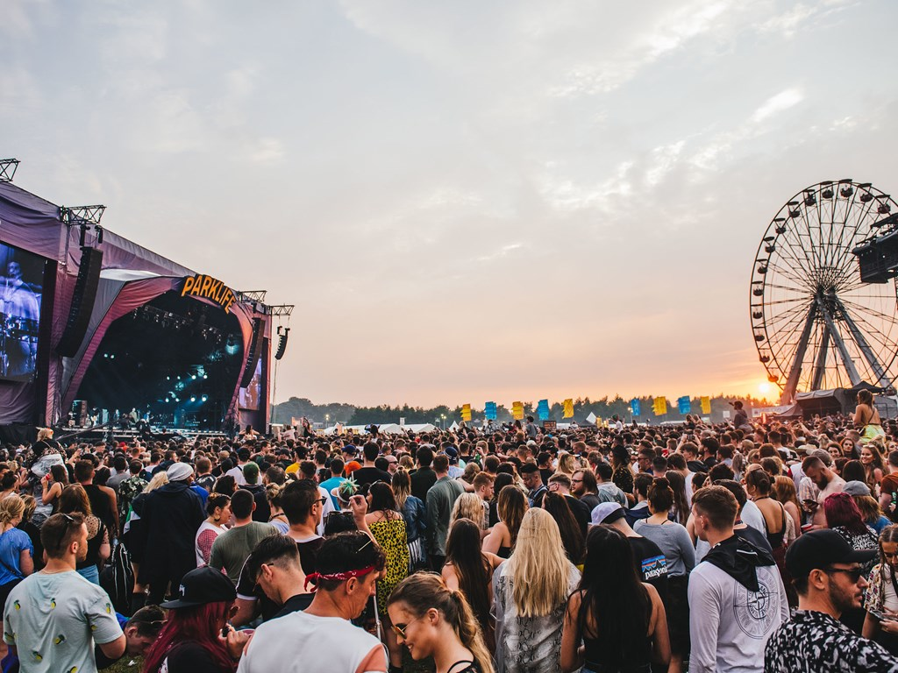
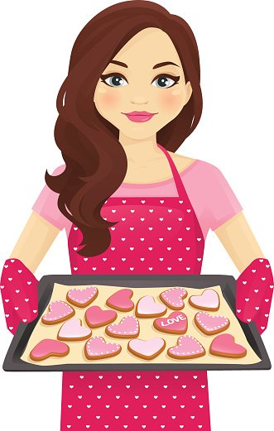
Hobbies!
Shopping
Music
Going to the gym
Baking & cooking

Slide 8
Now its your turn!
Tell me a bit about yourself.
You could write a letter or make a PowerPoint like me! Its up to you.
You could even tell me what you are looking forward to in Year 3.
I can’t wait to find out all about you!
Miss Malpass

