Slide 1
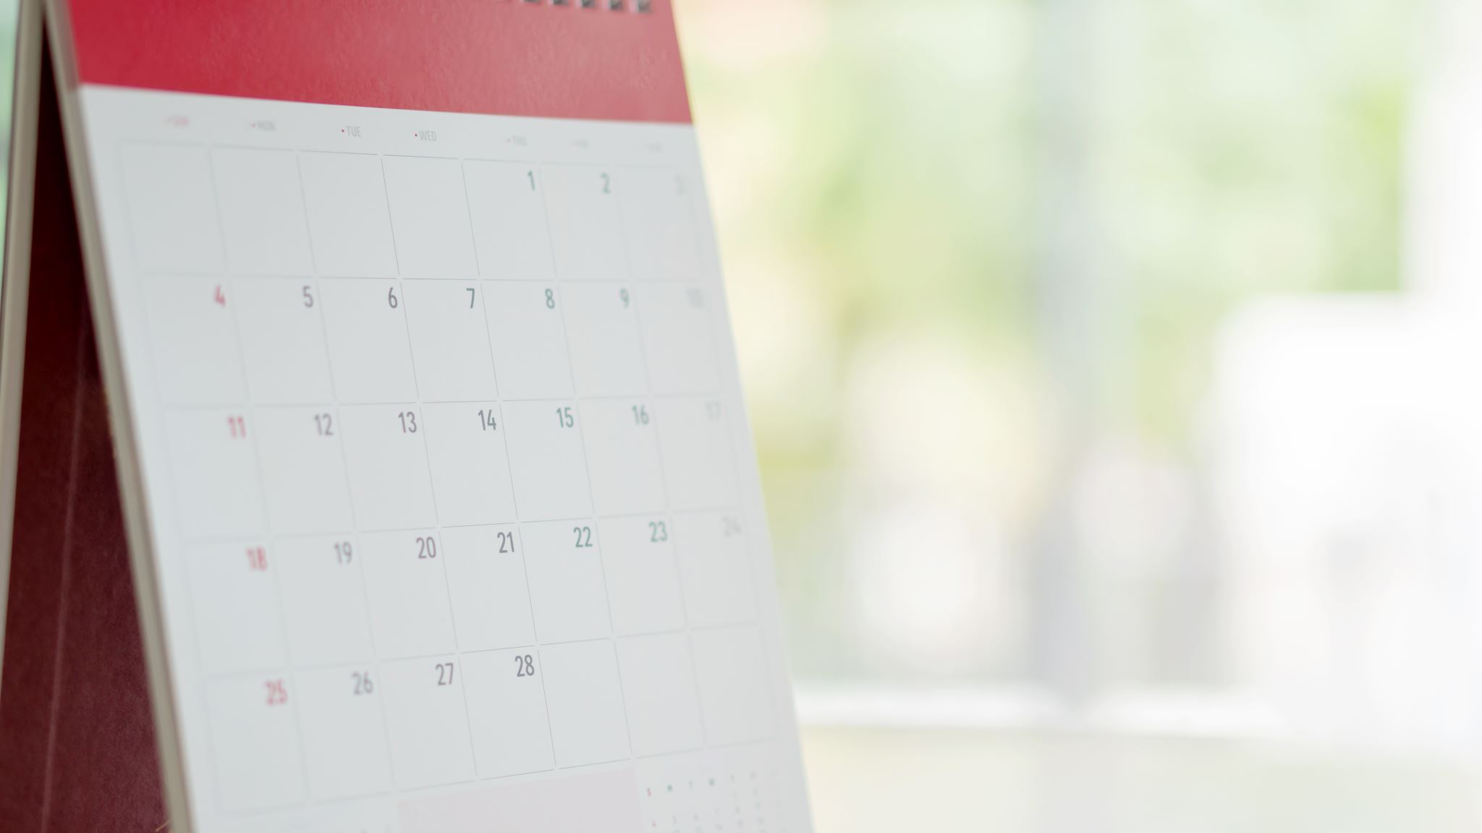
Year 2 SATs Meeting
We hope you find this useful and informative. ☺
Mrs Atkinson, Miss Malpass and Mrs Huston
.

Slide 2
Do not panic!
We do not want anybody worrying about these assessments. They are more our worry than yours!
It is important that the children do NOT know about these assessments. They will perform so much better without any worry/anxiety or stress.
Their best is good enough. Our teacher assessment will count for more than the assessments.

Slide 3
When, what and how?
SATs will take place around at any point during May – Make sure your child is in school!
They will be carried out in small groups with an adult (usually Mrs Atkinson, Miss Malpass or Mrs Huston) close by.
They are NOT timed.
6 assessment papers in total…
There are no tests in Writing or Science.

Slide 4
Writing – Working Towards

Slide 5
Writing – Working At

Slide 6
Writing – Greater Depth

Slide 7
Science

Slide 8
Maths…
Arithmetic Paper
20 questions
Covers addition, subtraction, multiplication, division and fractions
Reasoning Paper
Between 30/35 worded/problem solving questions
Selection of questions covering all elements of the Year 2 mathematics curriculum
Questions can be read to them (except key mathematical vocabulary)
The paper starts off with 5 questions that are verbally read by the teacher
Please
Click here to find all past KS1 SATS papers
https://www.testbase.co.uk/past-papers/

Slide 9
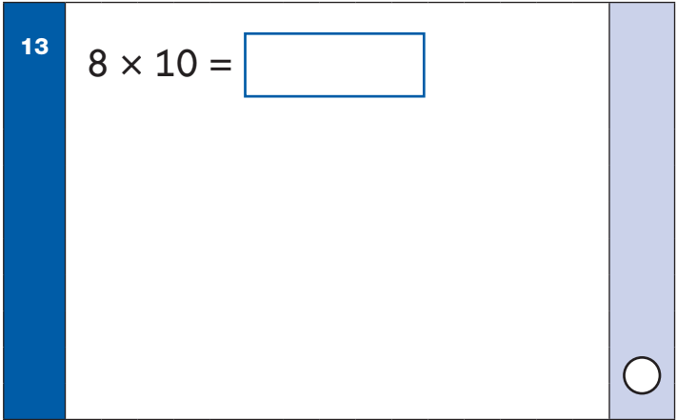
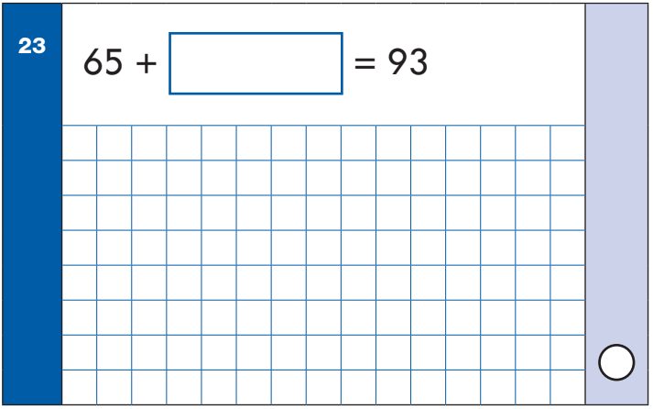
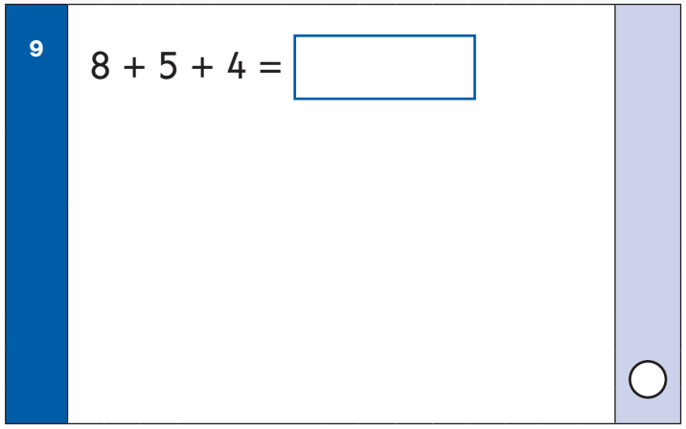
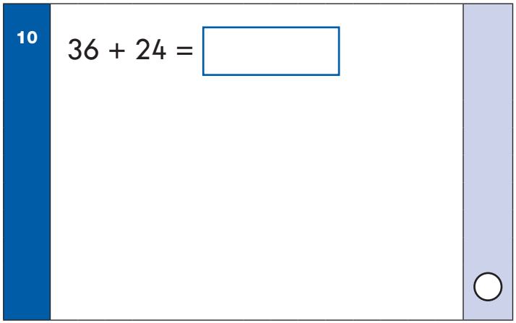
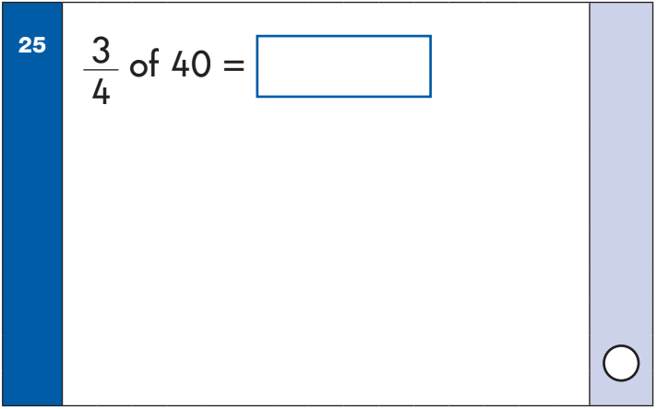
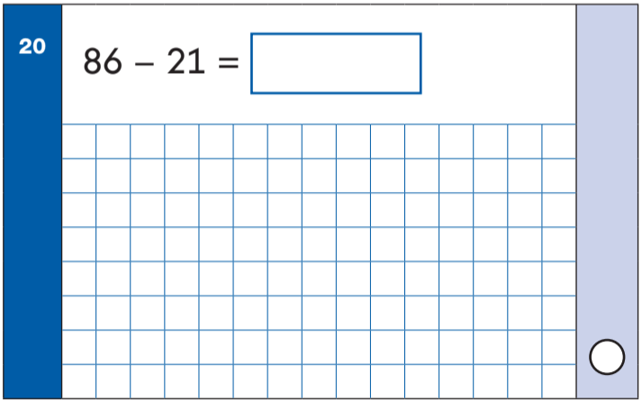
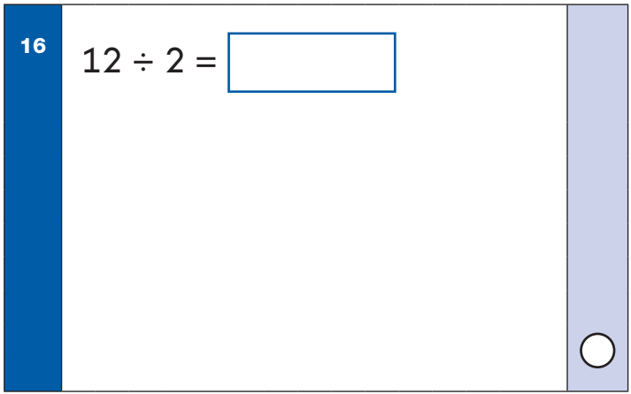
Arithmetic Paper

Slide 10
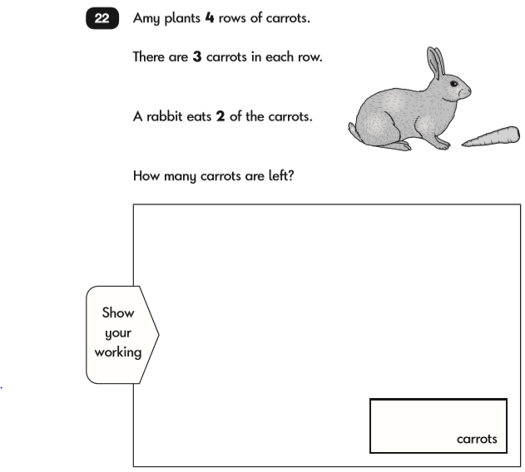
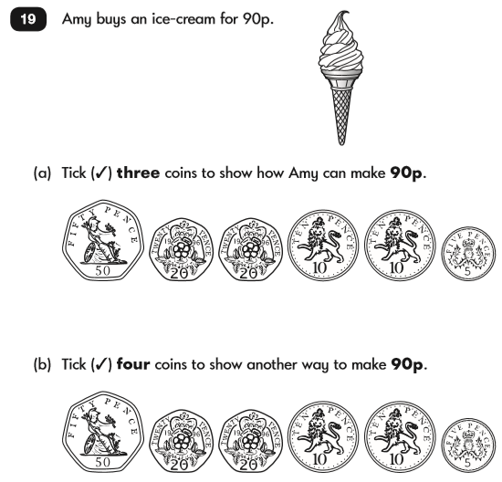
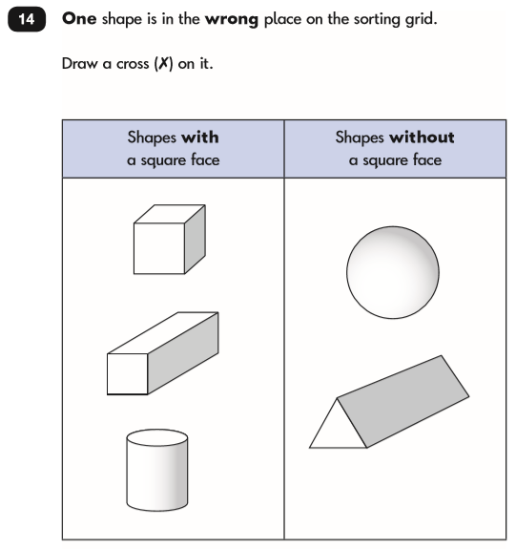
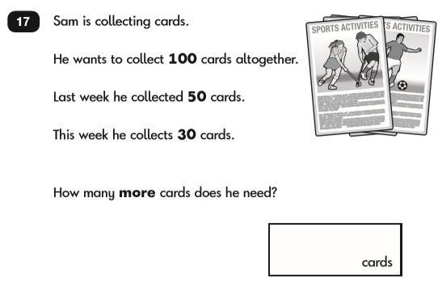
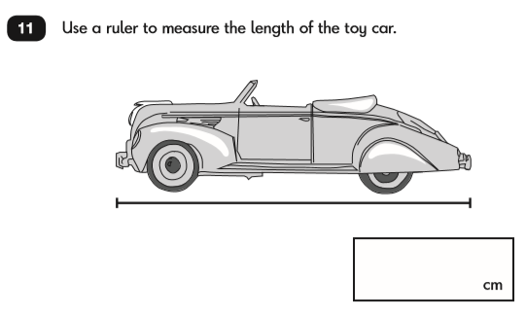
Reasoning Paper

Slide 11
Reading…
Reading Paper 1
20 questions
2/3 texts broken into short passages (fiction, non-fiction, poetry)
Retrieval, prediction, inference, sequencing
Reading Paper 2
A reading booklet and answer booklet
Around 20 questions
Retrieval, prediction, inference, sequencing
Please
Click here to find all past KS1 SATS papers
https://www.testbase.co.uk/past-papers/

Slide 12
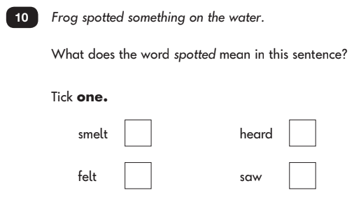
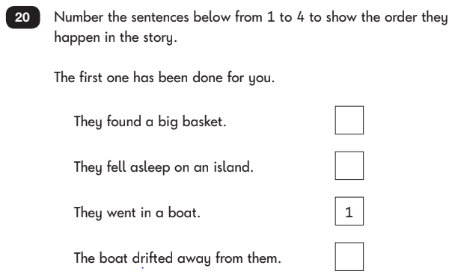
Reading Paper 1

Slide 13
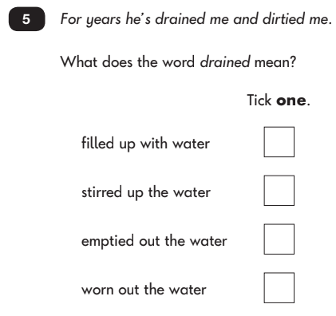
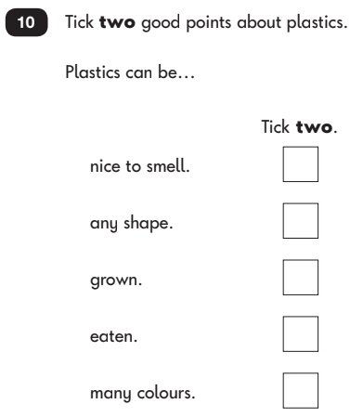
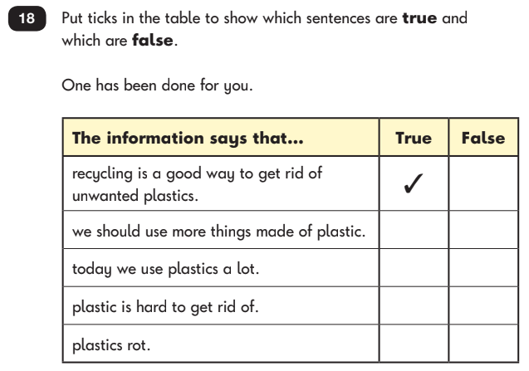
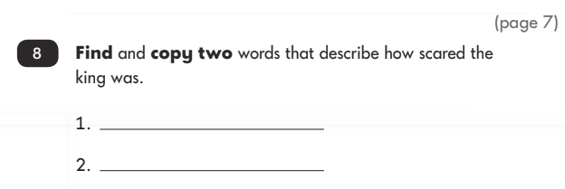
Reading Paper 2

Slide 14
SPAG (Spelling, Grammar and Punctuation)…
Please
Click here to find all past KS1 SATS papers
https://www.testbase.co.uk/past-papers/
Spelling Paper
20 questions
Dictation style sentences with the spelling word missing
Covering a range of spelling rules taught across Year 2 (inc. suffixes and prefixes)
Grammar and Punctuation Paper
20 questions
Word classes, tenses, sentence types, punctuation, suffixes/prefixes, plurals, contractions, conjunctions

Slide 15
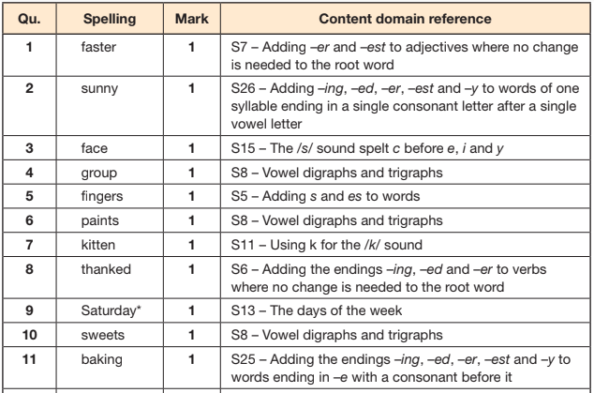
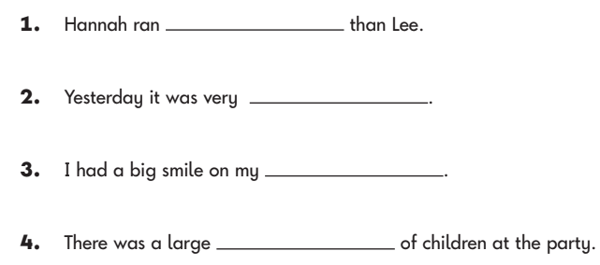
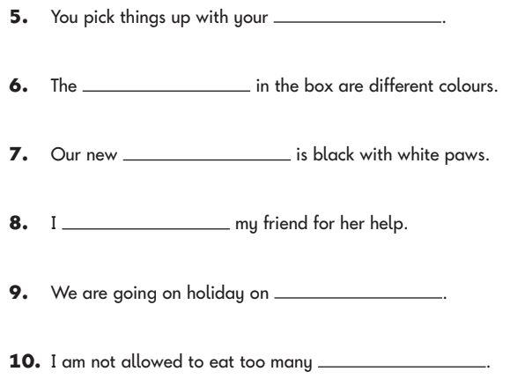
Spelling Paper

Slide 16
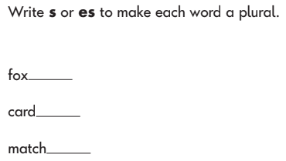
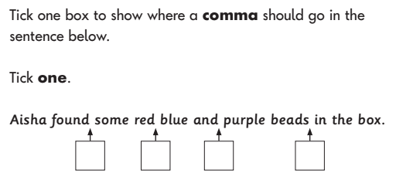
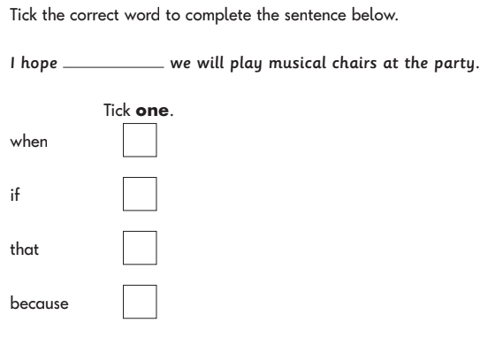
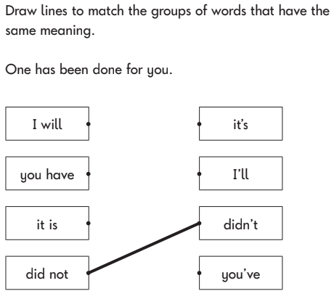
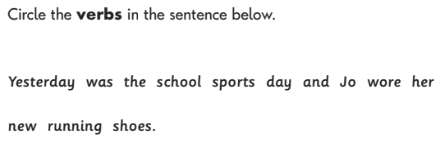
Grammar and Punctuation Paper

Slide 17
How can you help at home?
At home…
Reading - Use the question bookmark to ask additional questions about the text
Maths – Practise solving arithmetic questions as seen on the papers
Spelling -Practice the weekly spellings and go back through previous weeks ones too – can they remember any of them?
Grammar – conversations about nouns/verbs/adjectives/adverbs
Apps/Websites:
Whiterose Maths 1 minute maths
Numbots
T Rockstars
Hit the Button
BBC Bitesize – Small Town Superheroes
In the car:
Counting in 2s, 5s, 10s, 3s
10 more/less
Remember to NOT mention it to your child – they do not need to know!
Don’t panic or stress, they will all be absolutely AMAZING!

Slide 18
Reading at home…
Listening to your child read can take many forms:
First and foremost, focus developing an enjoyment and love of reading.
Enjoy stories together – reading stories to your child is equally as important as listening to your child read.
Read a little at a time but often, rather than rarely but for long periods of time!
Talk about the story before, during and afterwards – discuss the plot, the characters, their feelings and actions, how it makes you feel, predict what will happen and encourage your child to have their own opinions.
Look up definitions of words together – you could use a dictionary, the Internet or an app on a phone or tablet.
All reading is valuable – it doesn’t have to be just stories. Reading can involve anything from fiction and non-fiction, poetry, newspapers, magazines, football programmes, TV guides.
Visit the local library - it’s free!
next page

Slide 19
Writing at home…
Practise and learn weekly spelling lists – make it fun!
Encourage opportunities for writing, such as letters to family or friends, shopping lists, notes or reminders, stories or poems.
Write together – be a good role model for writing.
Encourage use of a dictionary to check spelling.
Allow your child to use a computer for word processing, which will allow for editing and correcting of errors without lots of crossing out.
Remember that good readers become good writers! Identify good writing features when reading (e.g. vocabulary, sentence structure, punctuation).
Show your appreciation: praise and encourage, even for small successes!

Slide 20
Maths at home…
Play times tables games.
Play mental maths games including counting in different amounts, forwards and backwards.
Encourage opportunities for telling the time.
Encourage opportunities for counting coins and money e.g. finding amounts or calculating change when shopping.
Look for numbers on street signs, car registrations and anywhere else.
Look for examples of 2D and 3D shapes around the home.
Identify, weigh or measure quantities and amounts in the kitchen or in recipes.
Play games involving numbers or logic, such as dominoes, card games,
draughts or chess.

