Slide 1
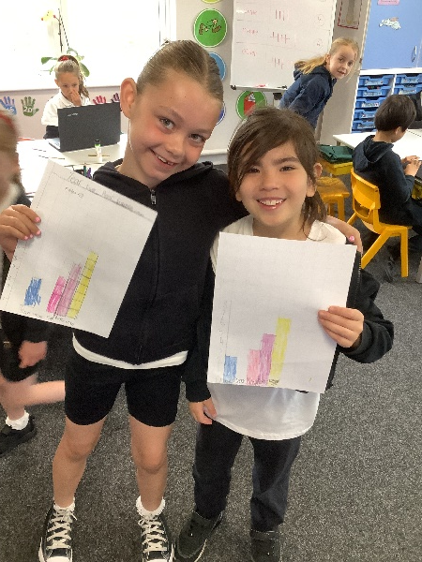
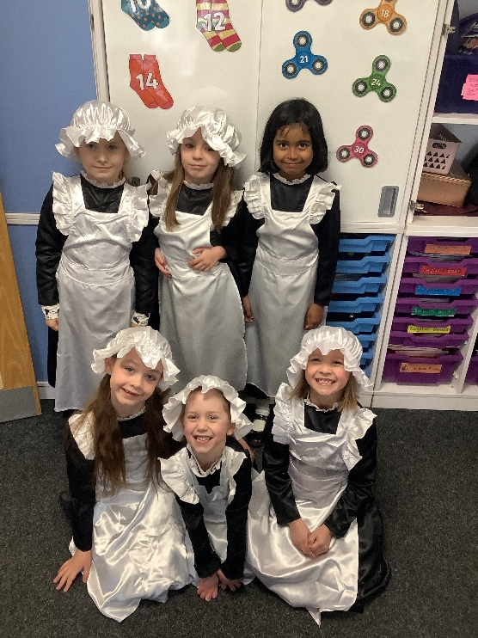
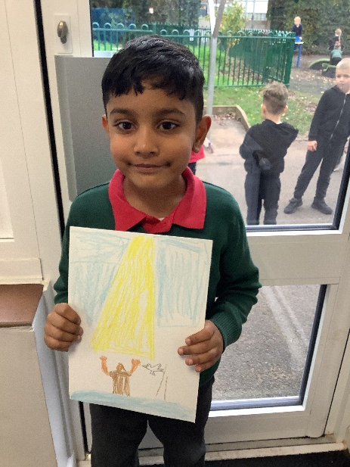
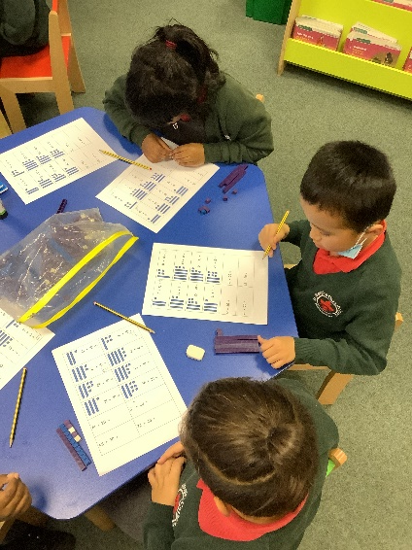
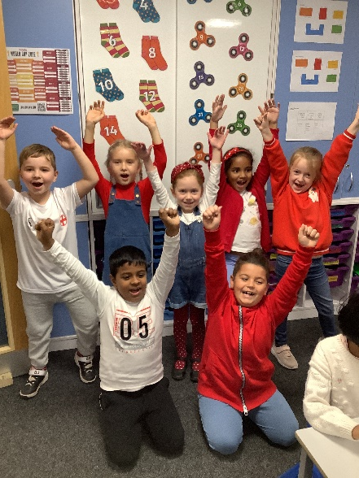
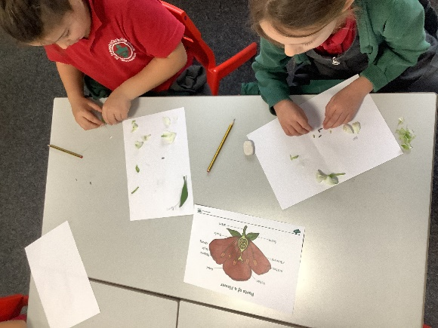
Welcome to
Year 2

Slide 2
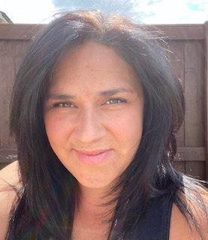
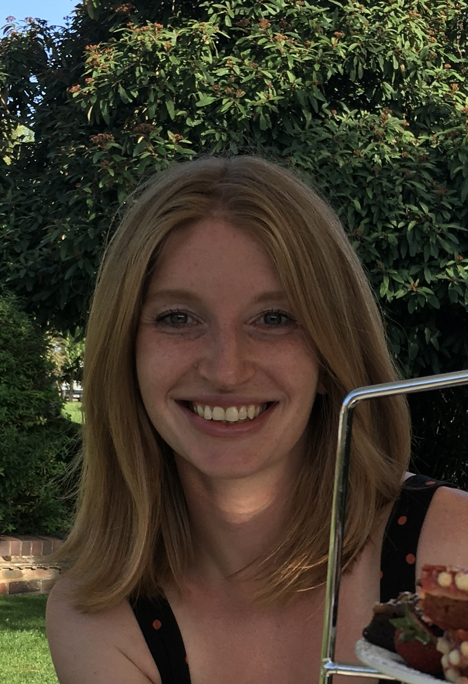
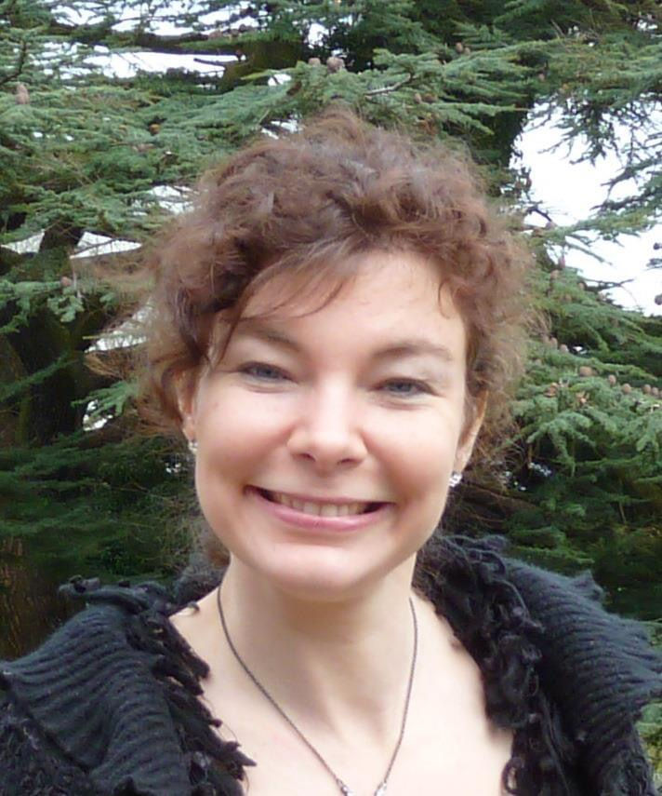
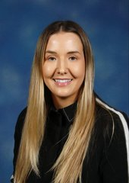
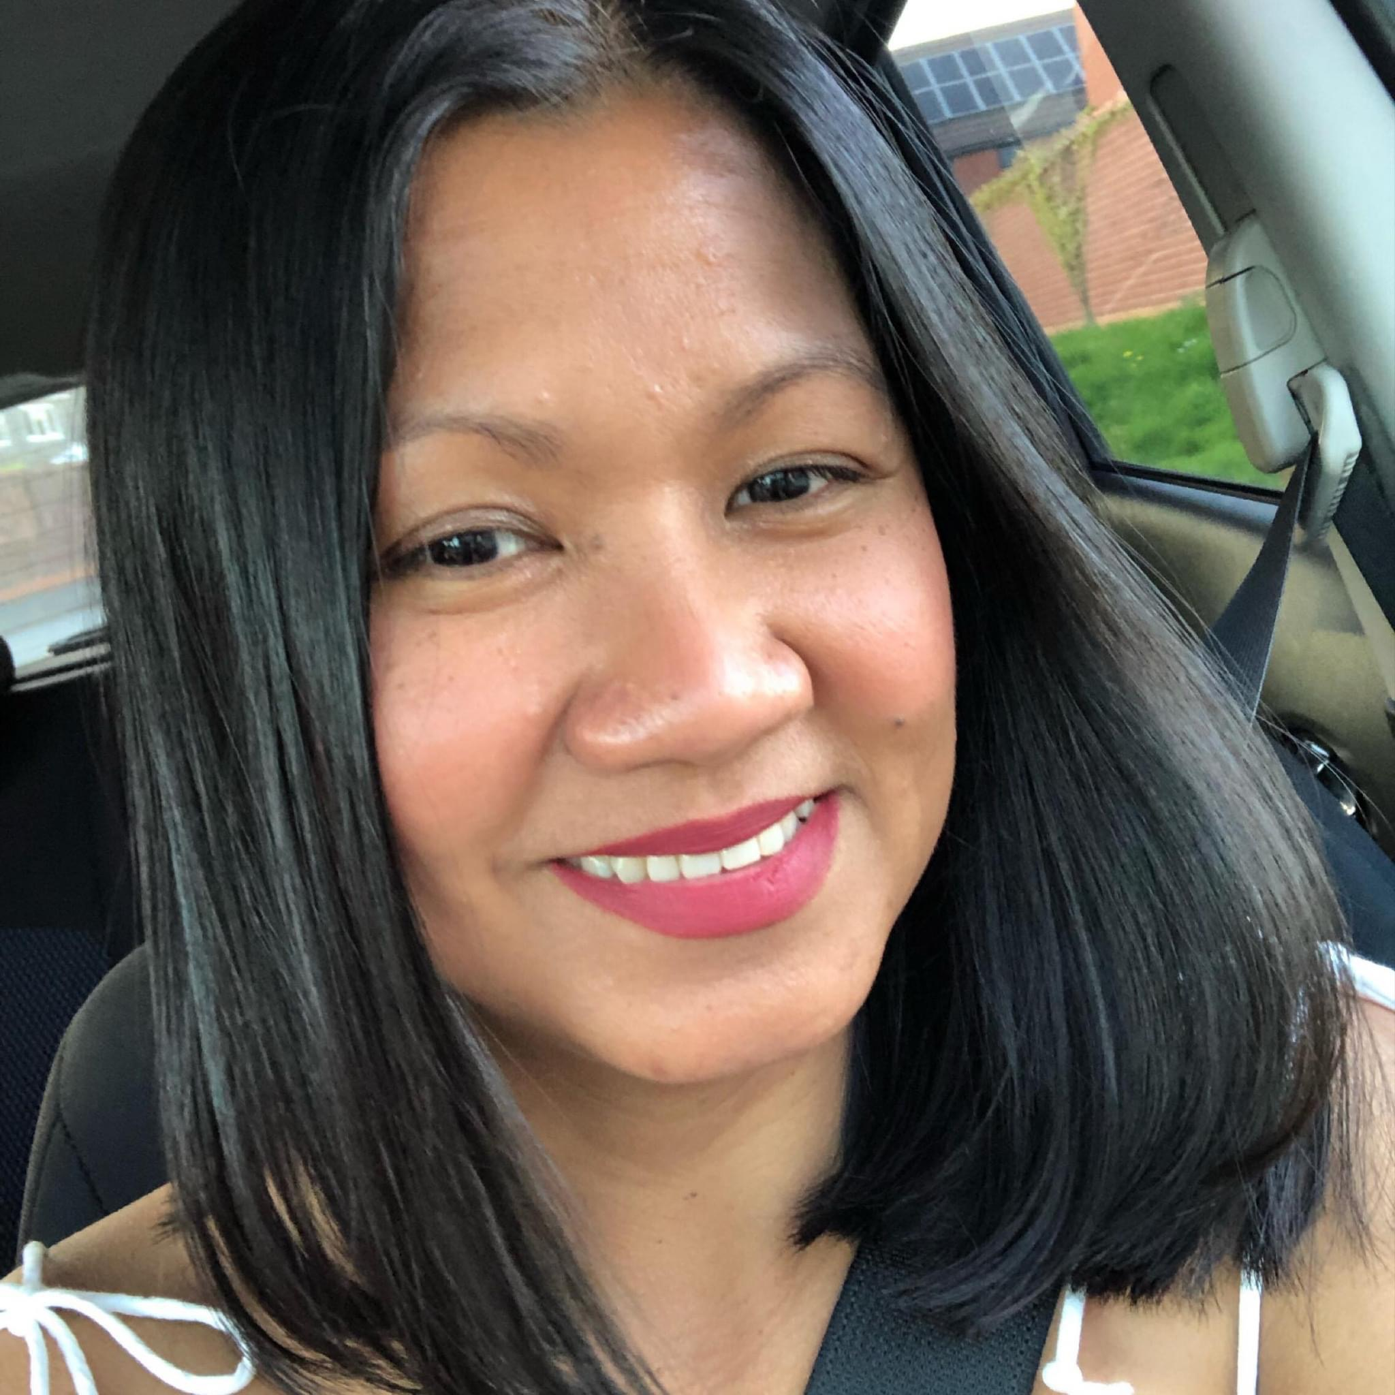
The Year 2 Team!
Year Two Oak
Year Two Pear
Mrs Huston – Mon-Wed
Miss Haines – Thurs & Fri
&
Mrs Ross
Miss Malpass
&
Mrs Hayman

Slide 3
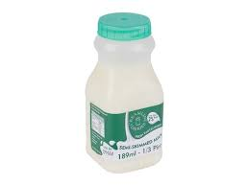
Snack and Lunch
Snack time - 10:00-10:20
Lunch - 12:25 – 1:25
Your child will have fruit during the day and milk is available to purchase.

Slide 4
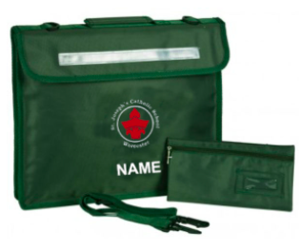
What will your child need?
Book bag (no back packs) containing their reading record, reading book and home learning book.
- Water bottle filled with only water.
PE kits worn during PE days. Please check your child's timetable in September.
A healthy snack (please no sweets or chocolate bars)

Slide 5
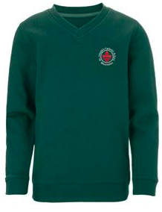
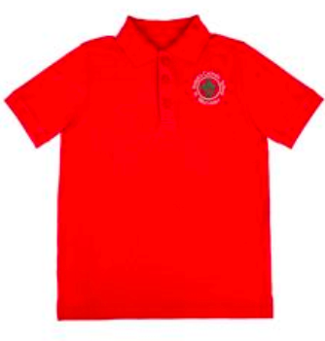
Uniform expectations
Uniform | PE Kit
Red polo top Grey trousers/skirt or pinafore Grey socks or tights Green jumper or cardigan School shoes – NO trainers Green summer dress | White round-neck t-shirt with or without logo Black shorts Black joggers (colder weather) Black hoodie/school fleece Dark trainers (preferably black)

Slide 6
Building Learning Power Characters
We teach the children about positive attitudes to learning through the life skills of the Building Learning Power Characters.
Have a Go Hare
Bradley Bat (Listening)
Busy Beaver (resourceful)
Resilient Rhino
Tom Tortoise (reflection)
Team Ant

Slide 7
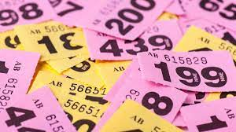
Behaviour & consequences

Slide 8
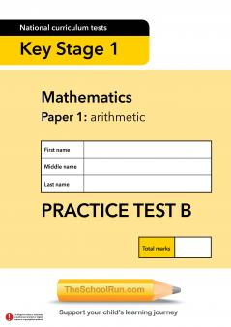
Year 2 Expectations
The SATs tests are no longer compulsory!
But it is a good way to assess your child, so we will be continuing testing but in an informal way.
2 Reading Comprehension test papers
Maths Arithmetic paper
Maths Reasoning paper
Spelling test
Spelling, Punctuation and Grammar Paper

Slide 9
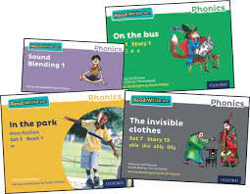
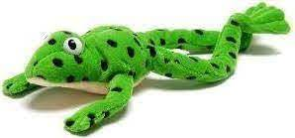
Phonics and Spellings
In the Autumn term, we will continue with daily phonics lessons. Throughout the year, children who require phonics support will continue to take part in daily phonics lessons.
Children will be given a half termly spelling sheet with spellings to be learnt for a weekly test.

Slide 10
Reading
Children will change their books within their phonics lesson
Children are expected to re-visit their book, answer questions on the text and improve fluency.
Parents please sign reading records 3 times per week!
By the end of Year 2, with age-appropriate books, children can read most words accurately without overt sounding and blending, and sufficiently fluently to allow them to focus on their understanding rather than on decoding individual words. They will also be able to sound out most unfamiliar words accurately, without undue hesitation.

Slide 11
Examples of Inference Questions
What words make you think that? Why?
How do you feel about………? Why?
Can you explain why………….?
At the end of the story the main character is feeling ……. Does this surprise you?
What does this tell you about what ……….was thinking?
Do you think this is true/untrue? Why do you think this?
What do you think the ………. is thinking? If it were you what would you be thinking?
Predict what you think is going to happen next. Why do you think this?
From what you have read, can you tell me what you feel about….?
Who would you like to meet most in the story? Why?
What is your opinion? What did you like/dislike about the story? Can you find pages in the book to show me?

Slide 12
As your children progress through the Read Write Inc books, they will eventually be given a login for accelerated reader. As teachers we decide when it is the appropriate time for children to access the accelerated reader programme.
AR is a computer based programme that helps us as teachers monitor children’s independent reading practice. Your child picks a book at his/her own level and reads it as his/her own pace. When finished, your child takes a short quiz on the computer – passing the quiz is an indication that your child has understood what they have read.

Slide 13
Writing in Year 2
Children will have the opportunity to write for a range of different purposes.
They will be encouraged to use the Year 2 key objectives for writing to make the expected standard.
Handwriting and presentation will be a big focus.

Slide 14
Maths in Year 2
Children will be expected to know the following number facts by the end of Year 2:
Count forwards and backwards in ones from any given number.
Counting forwards and backwards in 2,3,5,10.
Number bonds to 10, 20, 100.
2, 3, 5, 10 times tables.
Please take the time to practise every week.
You can use TTRockstars/Numbots or Hit the Button on Topmarks!

Slide 15
Maths Continued…
If you are unsure on how to teach your child a method, please speak to your class teacher.
Please ensure that your child forms their numbers correctly and can read and write numbers up to 100 (both words and numerals)

Slide 16
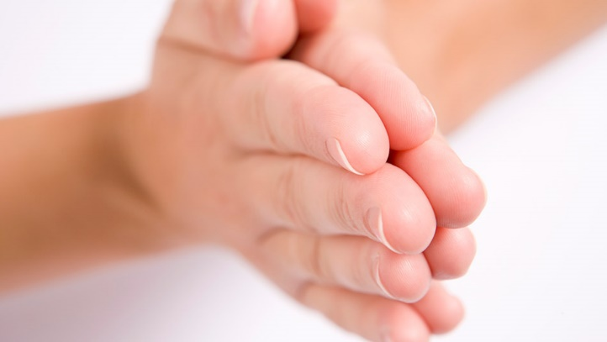
Catholic Life in Year 2
Children will take part in prayer and liturgy once a week and Mass throughout the term. Your child may be involved in planning and leading these events, if they are a liturgy planner. Please help your child learn any readings, stories sent home.
Year 2 Prayers:
The Prayer of St. Francis of Assisi
The Rosary
Eternal Rest
Act of Faith
Act of Hope

Slide 17
The RE curriculum can be found on our website.
Go to the home page, click on curriculum and then RE
https://www.stjosephsworcester.co.uk/curriculum/re

Slide 18
RSHE
As you will be aware, as part of our PSHE lessons we now use Ten Ten resources.
You will receive a login to access Ten Ten resources at home.

Slide 19
Home Learning
You will receive a home learning grid with various activities for different subjects within the year 2 curriculum. There will be enough activities for one activity to be completed per week per half term e.g. Autumn 1 will contain 7 activities as the term is 7 weeks long.
You can choose which activity you want to do.
Your child will receive a half termly spelling grid alongside this and will be tested in school every Friday.
Additionally, you should try and read with your child at least 3 times per week, signing their reading record.
Your child will receive log ins to various websites which will be in the front of the reading record. This will enable them to access these websites at home. E.g Times Table Rockstars

Slide 20
Potential Trips...
Visiting a castle
Selly Manor Museum (The Great Fire of London)
Theatre

Slide 21
Online Safety at St Joseph’s
Online safety is taught in class once per half term. Outside of these lessons it is something which we seek to promote an open discussion around with children.
Online safety covers a wide range of areas. From protecting children from harm by others to equipping children with an understanding of healthy and unhealthy use of technology (screen time for example).
Please do not hesitate to contact your child’s class teacher or Mr Bowring, our online safety co-ordinator, should you have any concerns about your child’s online activity or a wider online safety issue. Alternatively, you can report a concern about the way someone has been communicating online through the Child Exploitation and Online Protection Command (CEOP) here: https://www.ceop.police.uk/ceop-reporting/

Slide 22
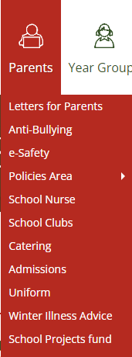
Online Safety at St Joseph’s
During Transition days, your child’s new teacher delivered a session on online safety, considering how best to safely use the school IT equipment.
An agreement was also shared with the children, which their teacher explained to them and they signed. This agreement, and the PowerPoint which was used to deliver the lesson can be viewed on our school website on the e-safety page (under parents)
If you haven’t already, please could you use the links
below to sign this electronically yourself as a parent/Carer.
Key Stage 1
https://forms.office.com/e/icLhK4MGuW
Key stage 2
https://forms.office.com/e/iPuzF3B44Y
The e-Safety page contains lots of useful and relevant information
regarding online safety

Slide 23
Online Safety at St Joseph’s
Working in partnership with parents to tackle online safety
During the next academic year, as a school we want to increase our reach and engagement with our parents when it comes to online safety issues.
If you would like to be a part of this journey as a parent, liaising with us as a school on online safety issues, please contact Mr Bowring at
year5oakparents@st-josephs-pri.worcs.sch.uk
If you haven't already done so, please sign up to the National Online Safety app here, when you register, set yourself as a parent to access all of the online safety resources available
https://nationalonlinesafety.com/enrol/st-joseph-s-catholic-primary-school-wr4-9pg

Slide 24
Any questions please email – Mrs Huston and Miss Haines year2oakclassroom@st-josephs-pri.worcs.sch.uk Miss Malpass year2pearclassrooms@st-josephs-pri.worcs.sch.uk If you are interested in being a parent volunteer to help out on trips etc there is now a form that you can fill in at the office to show interest :)

