Slide 1
English at St Joseph’s

Slide 2
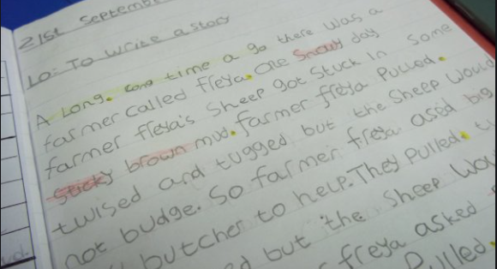
When I leave St Joseph’s…
I am going to be able to write and read my own stories.
How will this happen?

Slide 3
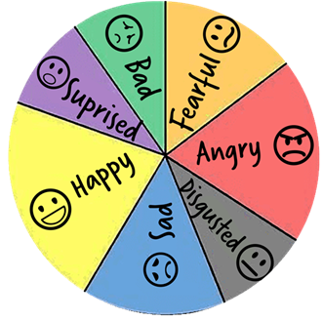
I will be able to…
express my thoughts and ideas with confidence in a manner appropriate to the situation

Slide 4
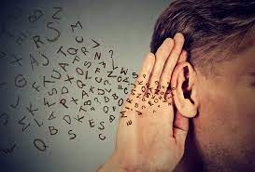
I will be able to…
listen to the ideas of others and respond thoughtfully and appropriately

Slide 5
I will be able to…
perform to small and large groups in a variety of ways

Slide 6
I will have a…
growing vocabulary and take interest in words and their meaning

Slide 7
I will be able to…
read and write with enjoyment, confidence, fluency and understanding

Slide 8
I will be able to…
orchestrate a full range of reading cues to monitor their reading and correct their mistakes

Slide 9
I will be …
interested in books and read with enjoyment

Slide 10
I will …
understand the sound and spelling system and use this to read and spell accurately

Slide 11
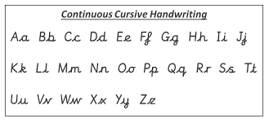
I will …
have fluent, legible, cursive handwriting

Slide 12
I will be able to…
understand and be able to write in a range of genres in fiction and poetry

Slide 13
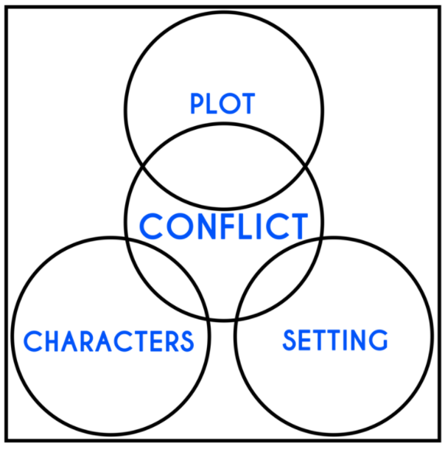
I will be able to…
understand and be familiar with some of the ways in which narratives are structured through basic literary ideas of setting, character and plot

Slide 14
I will be able to…
understand, use and be able to write a range of non-fiction texts

Slide 15
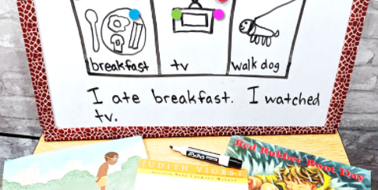
I will be able to…
plan, draft, revise and edit their writing

Slide 16
I will be able to…
have a suitable technical vocabulary through which to understand and discuss their reading and writing

Slide 17
I will be able to…
develop imagination, inventiveness and critical awareness when reading and writing.

