Slide 1
Religious Education at St Joseph’s

Slide 2
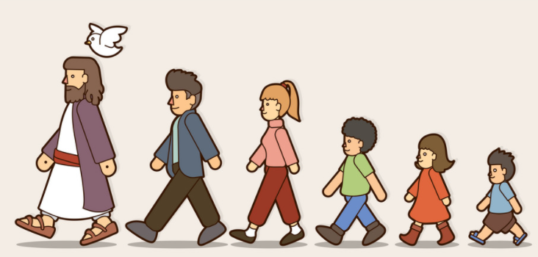
When I leave St Joseph’s…
I am going to show others how I follow Jesus in all I do...
What will this look like?

Slide 3
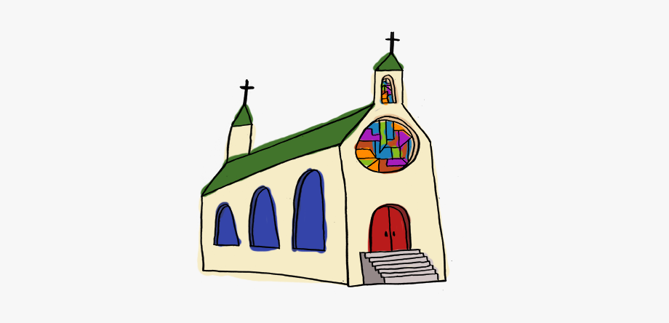
I will be able to…
talk confidently about my faith.

Slide 4
I will be able to…
ask wondering questions.

Slide 5
I will be able to…
retell some stories from the Bible.

Slide 6
I will be able to…
recite some important prayers.

Slide 7
I will be able to…
explain how the messages of Scripture impact on my life.

Slide 8
I will be able to…
name and talk about some of the important people in the history of the People of God.

Slide 9
I will be able to…
name religious symbols and say what they are used for.

Slide 10
I will be able to…
talk about the Sacraments and what happens at each one.

Slide 11
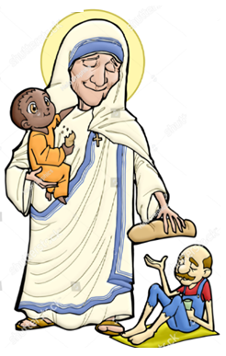
I will be able to…
talk about why some people act the way they do because of their beliefs.

Slide 12
I will be able to…
use religious vocabulary accurately and appropriately.

Slide 13
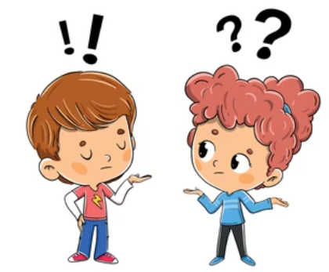
I will be able to…
express a viewpoint and give reasons for it.

Slide 14
I will be able to…
compare and contrast different points of view.

Slide 15
I will be able to…
respect, recognise and appreciate diversity.

