Slide 1
Modern Foreign Languages at St Joseph’s

Slide 2
When I leave St Joseph’s…
I am going to be able to communicate in a different language.
What will this look like?

Slide 3
I will be able to…
Listen and join in with songs, rhymes and stories.

Slide 4
I will be able to…
Speak with increasing confidence and fluency.

Slide 5
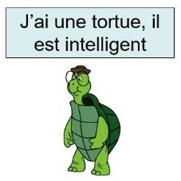
I will be able to…
Describe people, places and things orally and in writing.

Slide 6
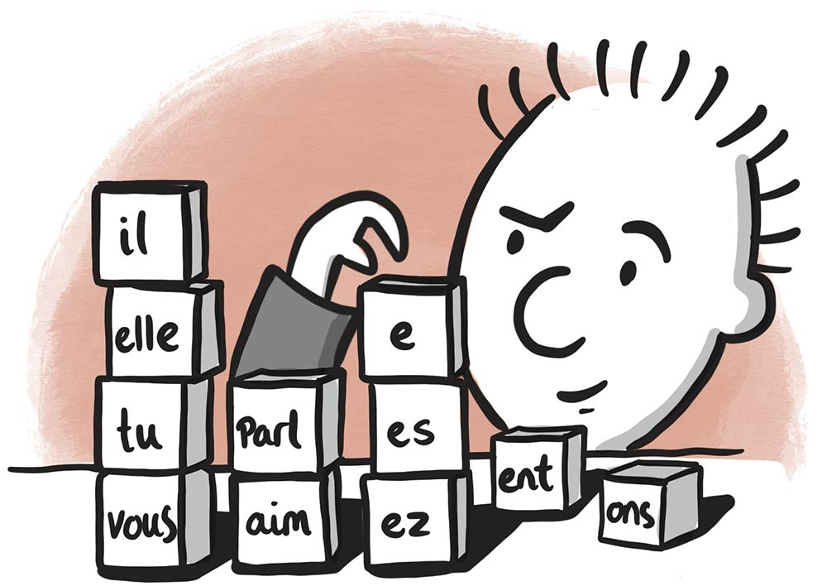
I will be able to…
Understand basic grammar.

Slide 7
I will be able to…
Read with increasing confidence.

Slide 8
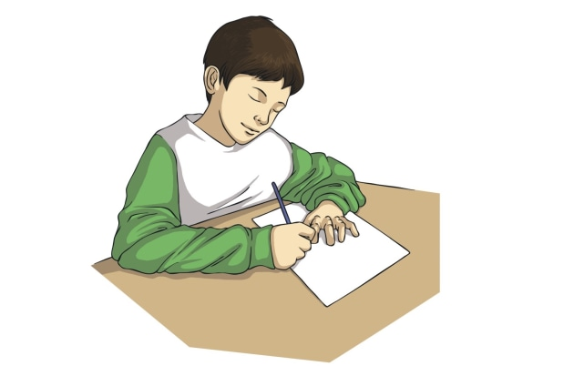
I will be able to…
Begin to write sentences using the grammatical features I have learnt.

