Slide 1
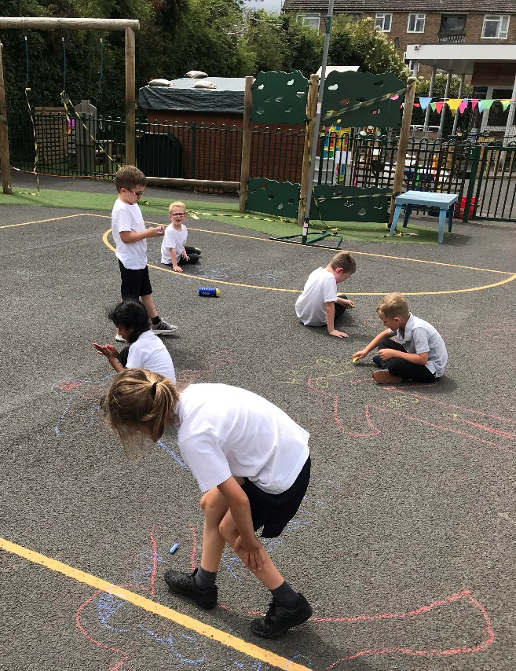
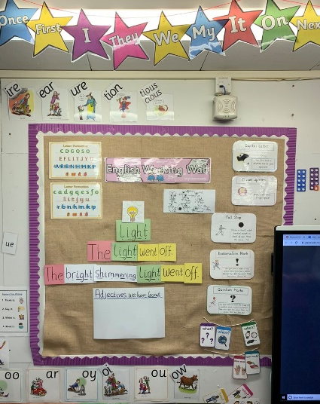
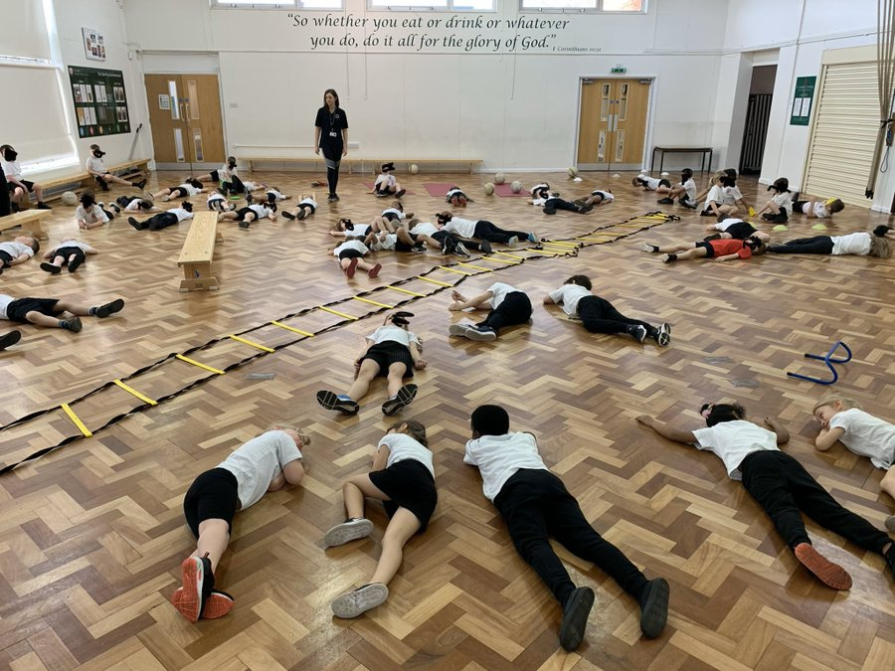
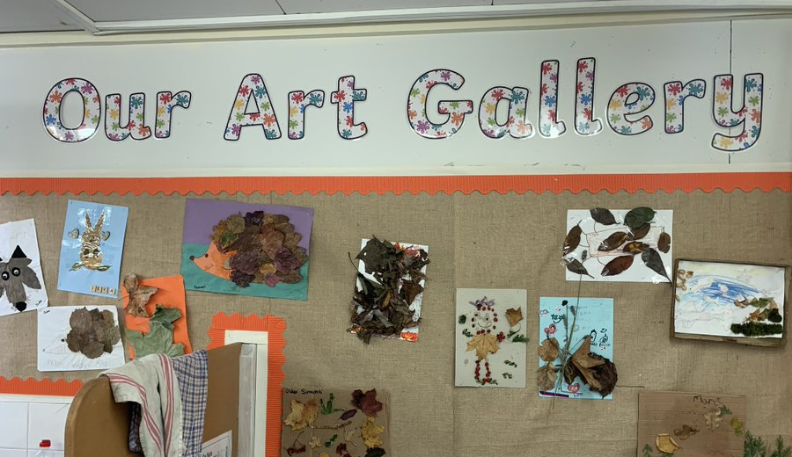
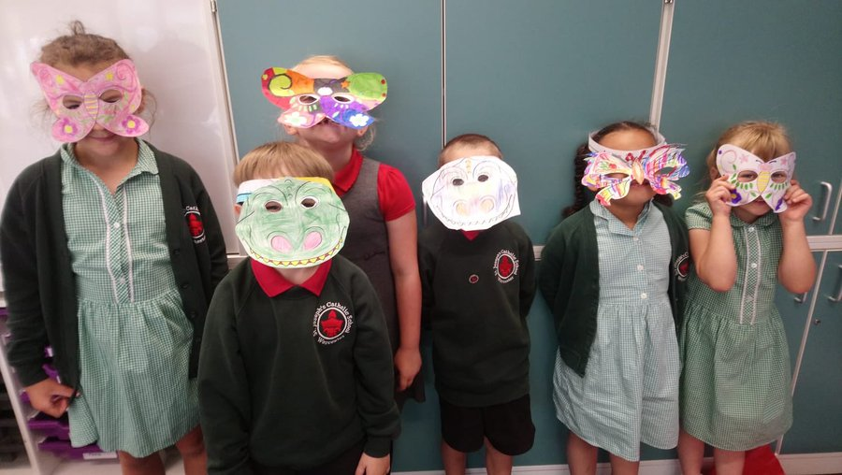
Year One at St Joseph’s

Slide 2
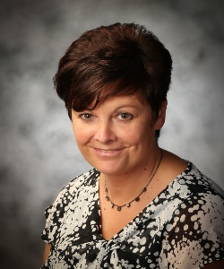
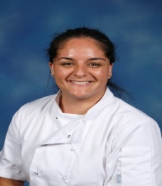
The Year One Team!
Year One Pear
Year One Oak
Mr Oates
Mrs O
Miss Farmer
Mrs Teague

Slide 3
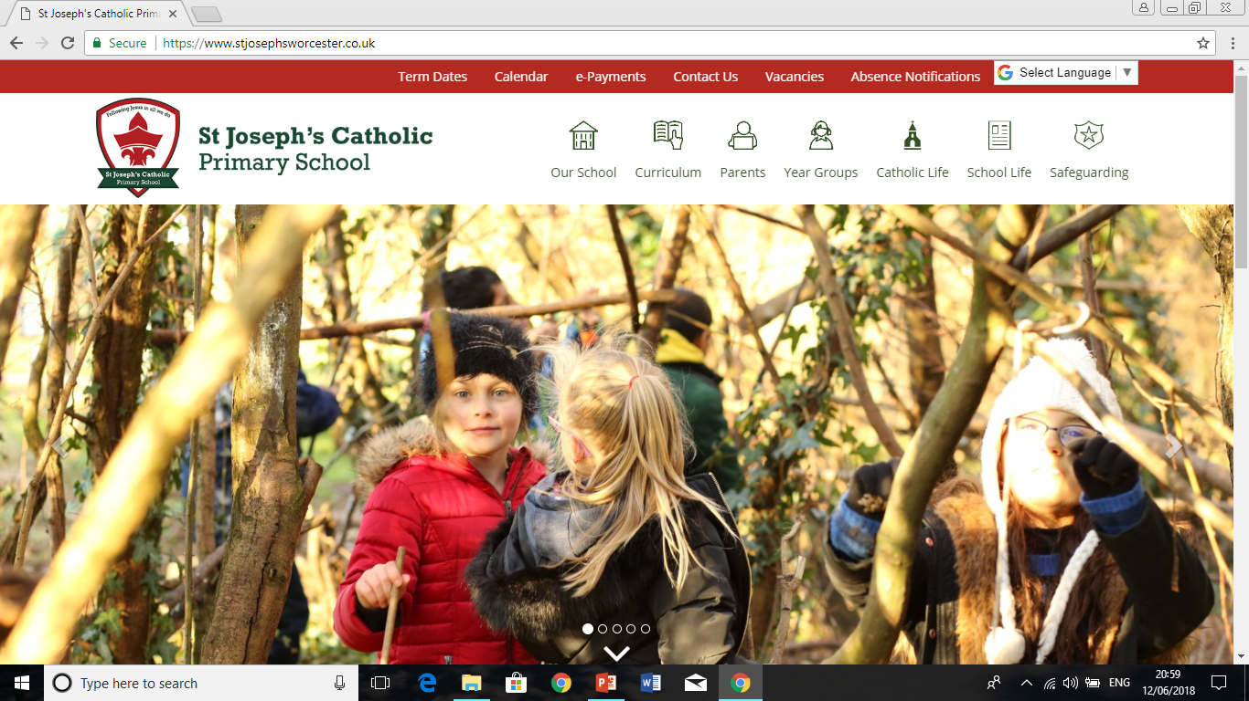
The school website
https://www.stjosephsworcester.co.uk/
To log absences
Curriculum
Policies
Newsletters
E-payments
Contact details
Term dates/calendar

Slide 4
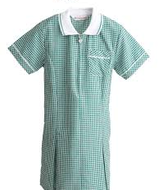
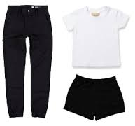
Uniform
Red polo top
Grey trousers
Grey skirt or pinafore with grey tights/socks
Green summer dress
With white socks.
PE kit on PE days
No jewellery or earrings – if earrings cannot be taken out they need to be taped up. ** PLEASE SUPPLY YOUR OWN TAPE **
Black shorts
White top
Black trainers
Black jogging bottoms
Black jacket

Slide 5
Transition to Year One
To ensure a smooth transition from Reception to Year 1 we begin the Autumn term with formal learning in the morning and a learning through play approach in the afternoon.
As the Year progresses the children will grow in independence and learning will become more structured throughout the day. Children can find the transition difficult at first but find methods to support this.

Slide 6
Building Learning Power Characters
We teach the children about positive attitudes to learning through the life skills of the Building Learning Power Characters.
Have a Go Hare
Bradley Bat (Listening)
Busy Beaver (resourceful)
Resilient Rhino
Tom Tortoise (reflection)
Team Ant

Slide 7
The Year One Timetable
Every week Year One have:
Two PE sessions
Little Leaves
Two RE lessons (Collective Worship)
Topic: Science, History, Geography, Art, Design and Technology & Music
Four English lessons
Four Maths
Daily Phonics Lessons
Weekly Spelling Tests

Slide 8
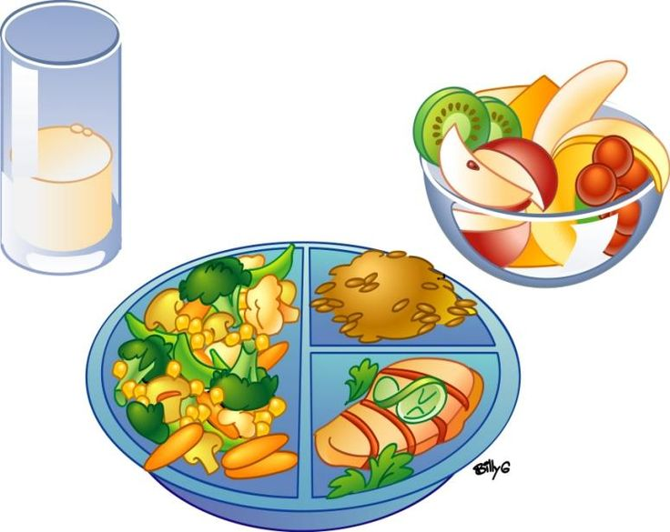
The Year One Timetable
We have two morning breaks:
Snack play – please provide a healthy snack
Fruit break during the morning – fruit will be provided or you can bring your own if you wish
Milk – Can be paid for at the office
Lunch

Slide 9
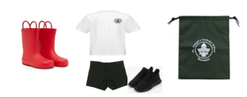
What your child will need….
Book bag containing their reading record, reading book, spelling book, homework book.
Please make sure your child has their reading record and book in their bag everyday!
Water bottle filled with only water.
Little Leaves wellies.

Slide 10
Home learning in Year One
We change our books every Monday where your child will take home 3 books at their level. They will also take home a story book to share over the weekend.
Spellings will be given out half termly and children will be tested every Friday.
Your child will receive their Education City, Numbots and Purple Mash username and password
Weekly home learning tasks will be set on Tapestry.

Slide 11
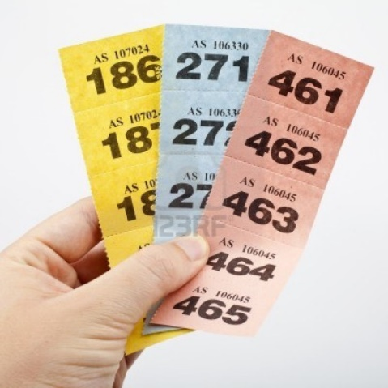
Behaviour Policy
Raffle tickets for good effort.
Zone board for good behaviour.

Slide 12
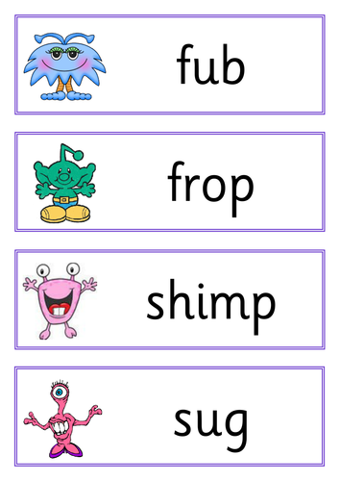
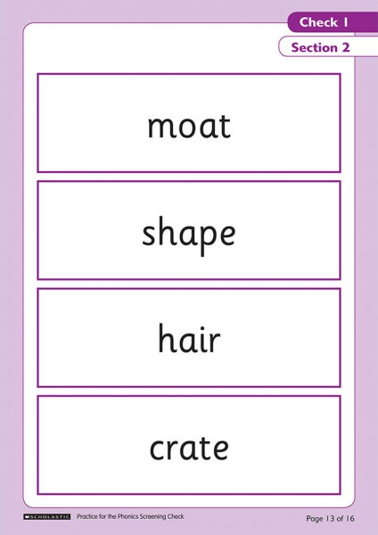
Phonics in Year One
Daily phonics lessons help prepare the pupils for the Phonics Screening in June.

Slide 13
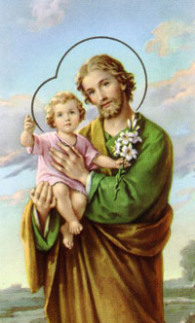
Prayer in Year 1
Morning, lunchtime and home time prayer.
The Lord’s prayer
Hail Mary
Glory be
Guardian Angel prayer

Slide 14
E-safety
Looking at how we as a school and you as parents can keep children safe online.
Key websites:
https://www.saferinternet.org.uk/advice-centre/parents-and-carers
https://www.nspcc.org.uk/preventing-abuse/keeping-children-safe/online-safety/
https://www.childnet.com/parents-and-carers
https://www.thinkuknow.co.uk/parents/

Slide 15
Youtube
5 ways to make Youtube safer
https://www.youtube.com/watch?v=N8P_6aj8VbU
Youtube for kids
www.forkidstube.com

Slide 16
English in Year One: Reading
Greater understanding/comprehension of text.
Prediction, inference and spotting language and punctuation within text (SPAG).
Phonics: Split diagraphs (make, cake, some, cone, time)
Exploring a wide range of texts: Fiction and non fiction, magazines, newspapers, road signs, leaflets, cereal boxes, websites etc.
Use of expression whilst reading.

Slide 17
English in Year One: Writing
Huge focus on SPAG: spelling, punctuation and grammar.
Re-reading work. Does your work make sense?
Editing work (purple pen)
Using different writing techniques: full stops, capital letters, adjectives, connectives, sentence starters, suffixes (jumped), prefixes (unhappy)
Using a narrative voice.

Slide 18
Maths in Year One: Number, Place Value and Calculation
Counting up to 100 forwards and backwards
Reading and writing numbers up to 100
Reading and writing numbers up to 20 in words
Counting on and back in twos, fives and tens
Using a number line to put numbers in the correct order
Recognising patterns in numbers
Recognising odd and even numbers
Estimating amounts of objects and then counting to check
Learning simple addition and subtraction
Using money – paying and giving change
Learning which pairs of numbers add up to 20 (number bonds)
Doubling and halving
Finding a quarter of a quantity
Working out multiplication and division questions using objects to group or share.

Slide 19
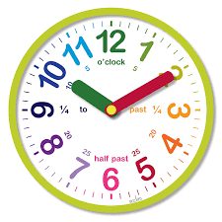
Maths in Year One: Measuring and Geometry
Telling the time to the hour and half hour
Putting the days of the week and months of the year in order
Measuring length, weight and capacity and comparing these measurements
Recognising, naming and describing common 2D and 3D shapes.
Using shapes to make patterns, models and pictures
Describing whole, half, quarter and three-quarter turns

Slide 20
We hope you know a little more about Year One now. If you have any questions please let us know on Year 1 Pear Mr Oates- year1pear@st-josephs-pri.worcs.sch.uk Year 1 Oak Miss Farmer- year1oakclassroom@st-josephs-pri.worcs.sch.uk

